Slide 1



RETAIL SITE SELECTION
Group 6

Slide 2
Table of Contents
Business Case Statement
Exploratory Data Analysis
Demographic
Property
Competitors
Variable Selection & Regression Analysis
Prediction Model
Predicted Locations
Appendix

Slide 3
Business Case Statement
Predict next potential store locations for T.J. Maxx, Marshalls and HomeGoods in Florida, Alabama and Tennessee leveraging data science. Number of Locations by each store and state :
State | Store | Number of Stores
Florida | T.J. Maxx | 10
 | Marshalls | 10
 | HomeGoods | 10
Alabama | T.J. Maxx | 5
 | Marshalls | 3
 | HomeGoods | 3
Tennessee | T.J. Maxx | 5
 | Marshalls | 3
 | HomeGoods | 3

Slide 4
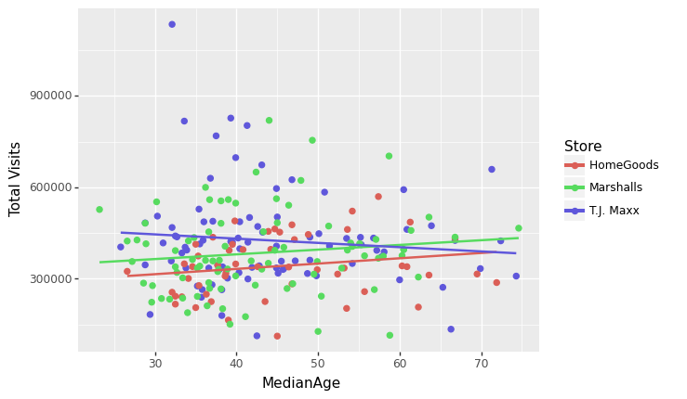
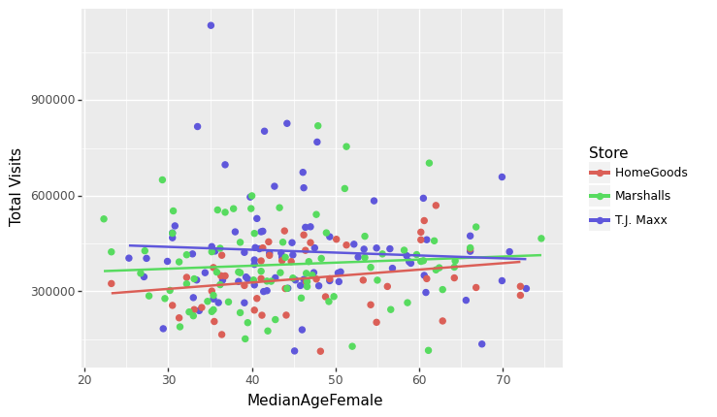
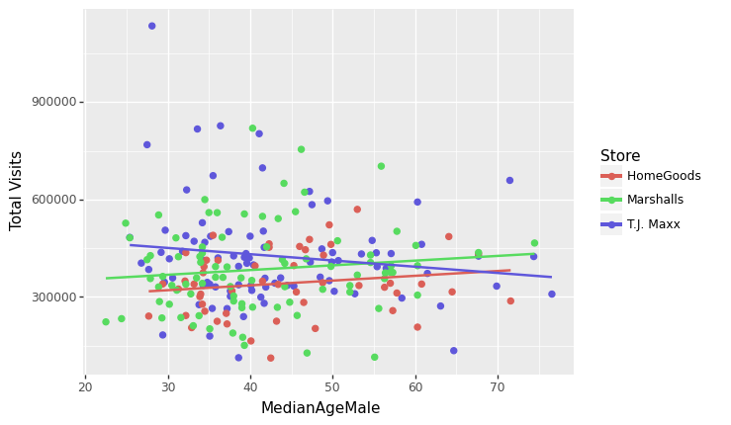
Total Visits vs Median Female Age
Total Visits vs Median Male age of Tract
Initial Analysis - Store Visits v/s Demographics
Total Visits vs Median Age of Tract

Slide 5
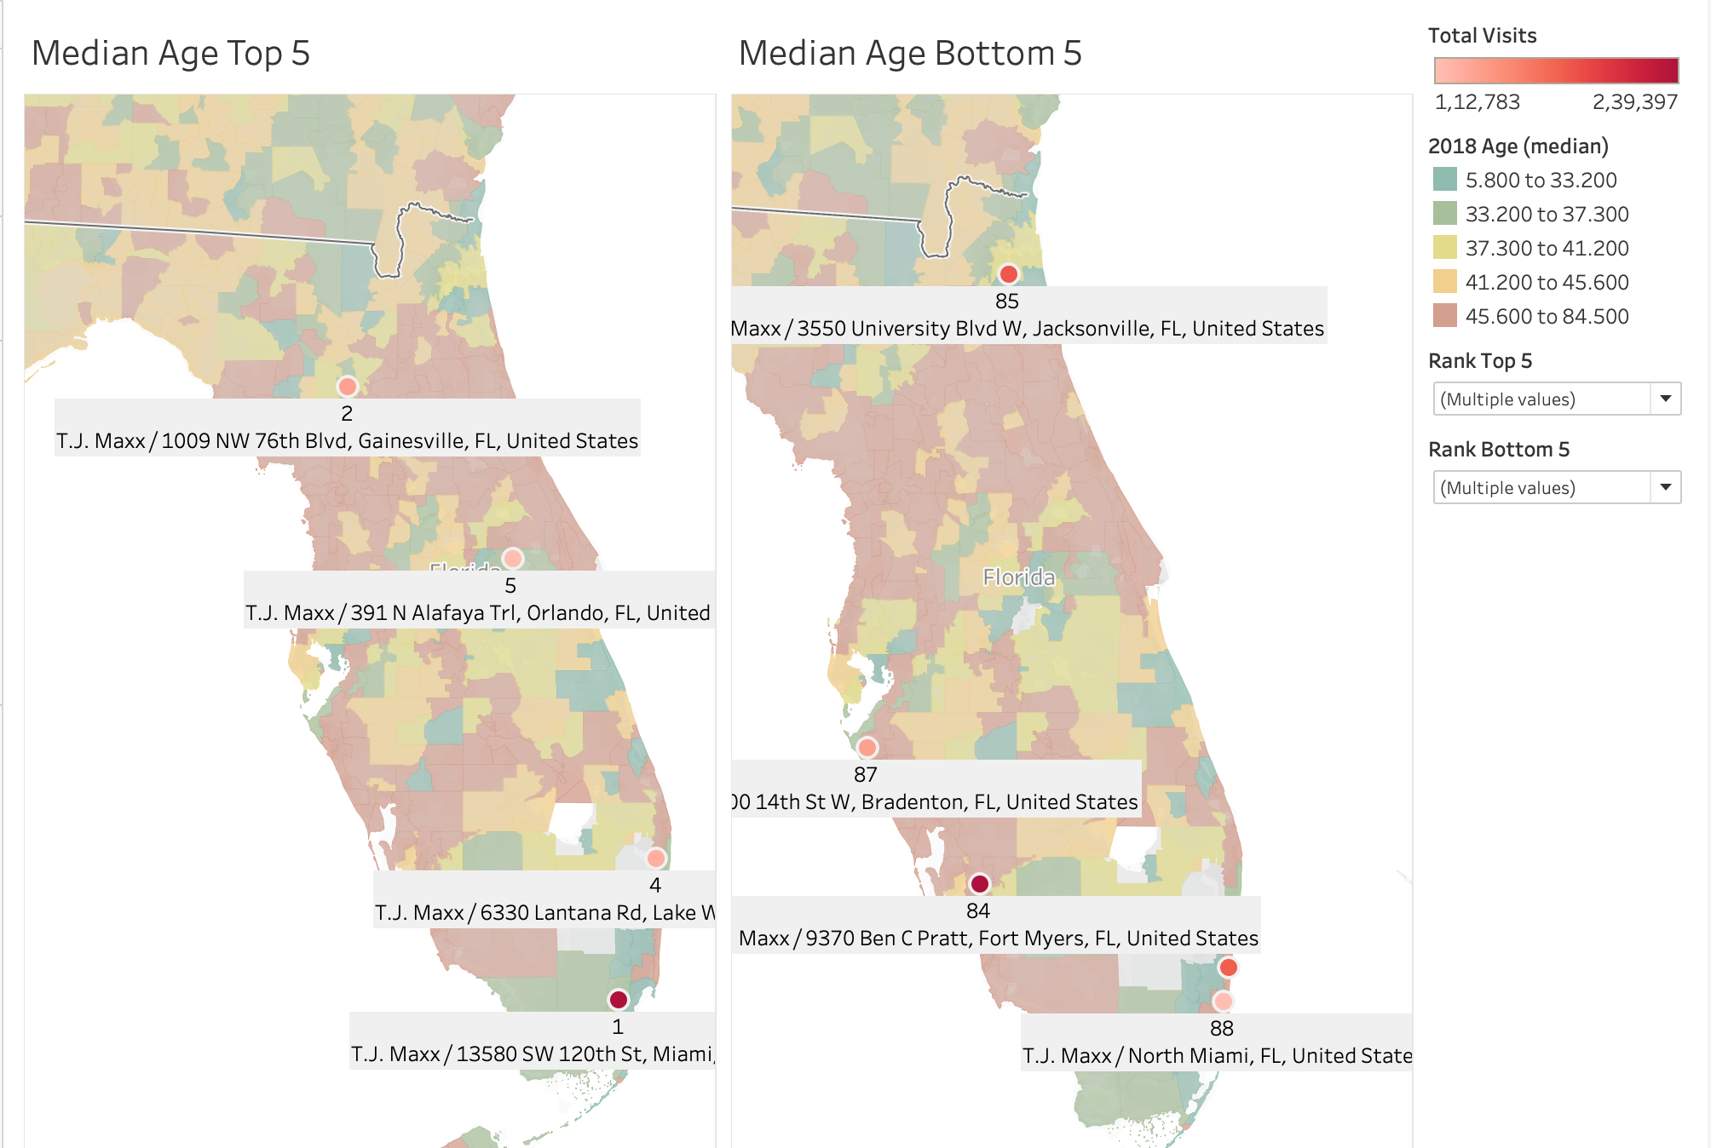
Top 5 stores in neighbourhoods with median age upto 37
Bottom 5 stores in neighbourhoods with median age above 41

Slide 6
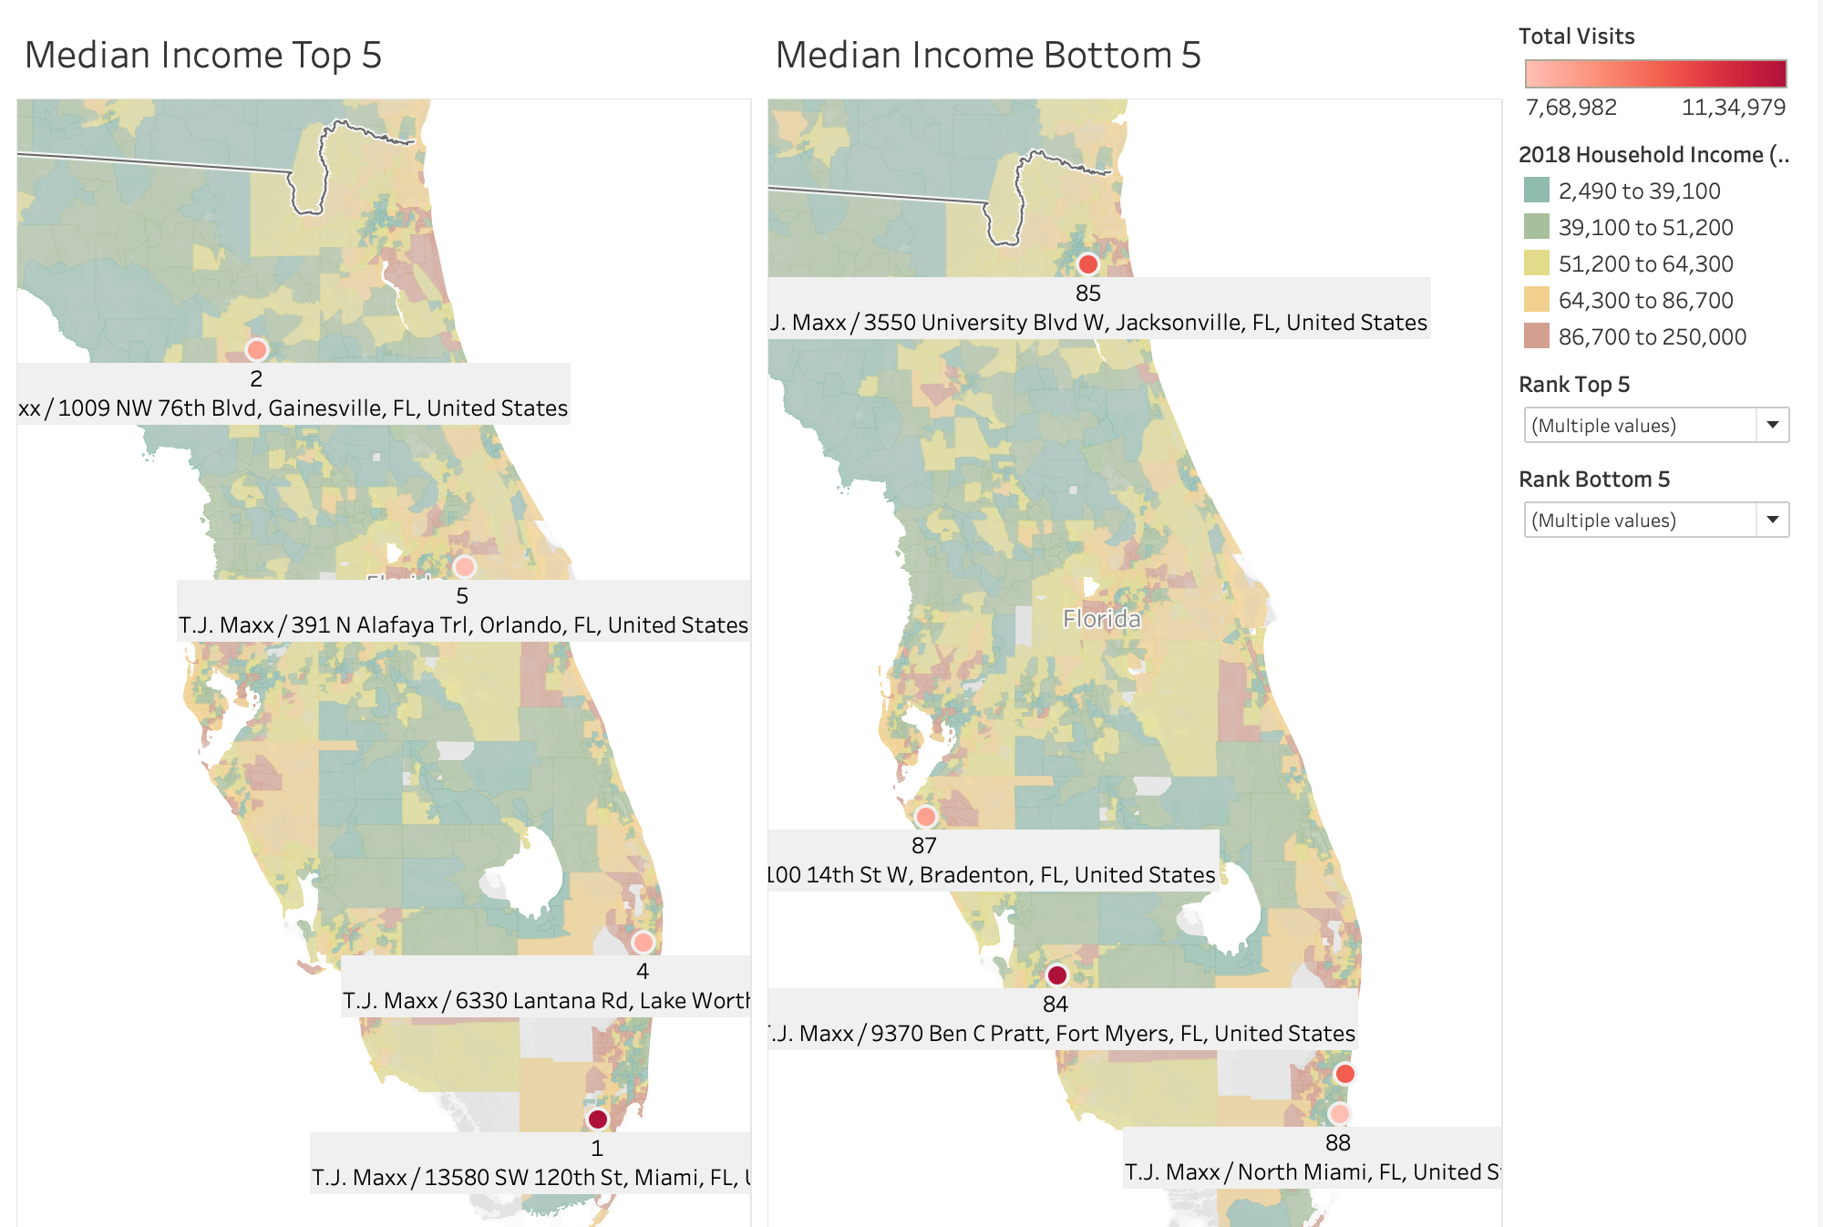
Top 5 stores in neighbourhoods with medium to high median household income
Bottom 5 stores in neighbourhoods with low median household income

Slide 7
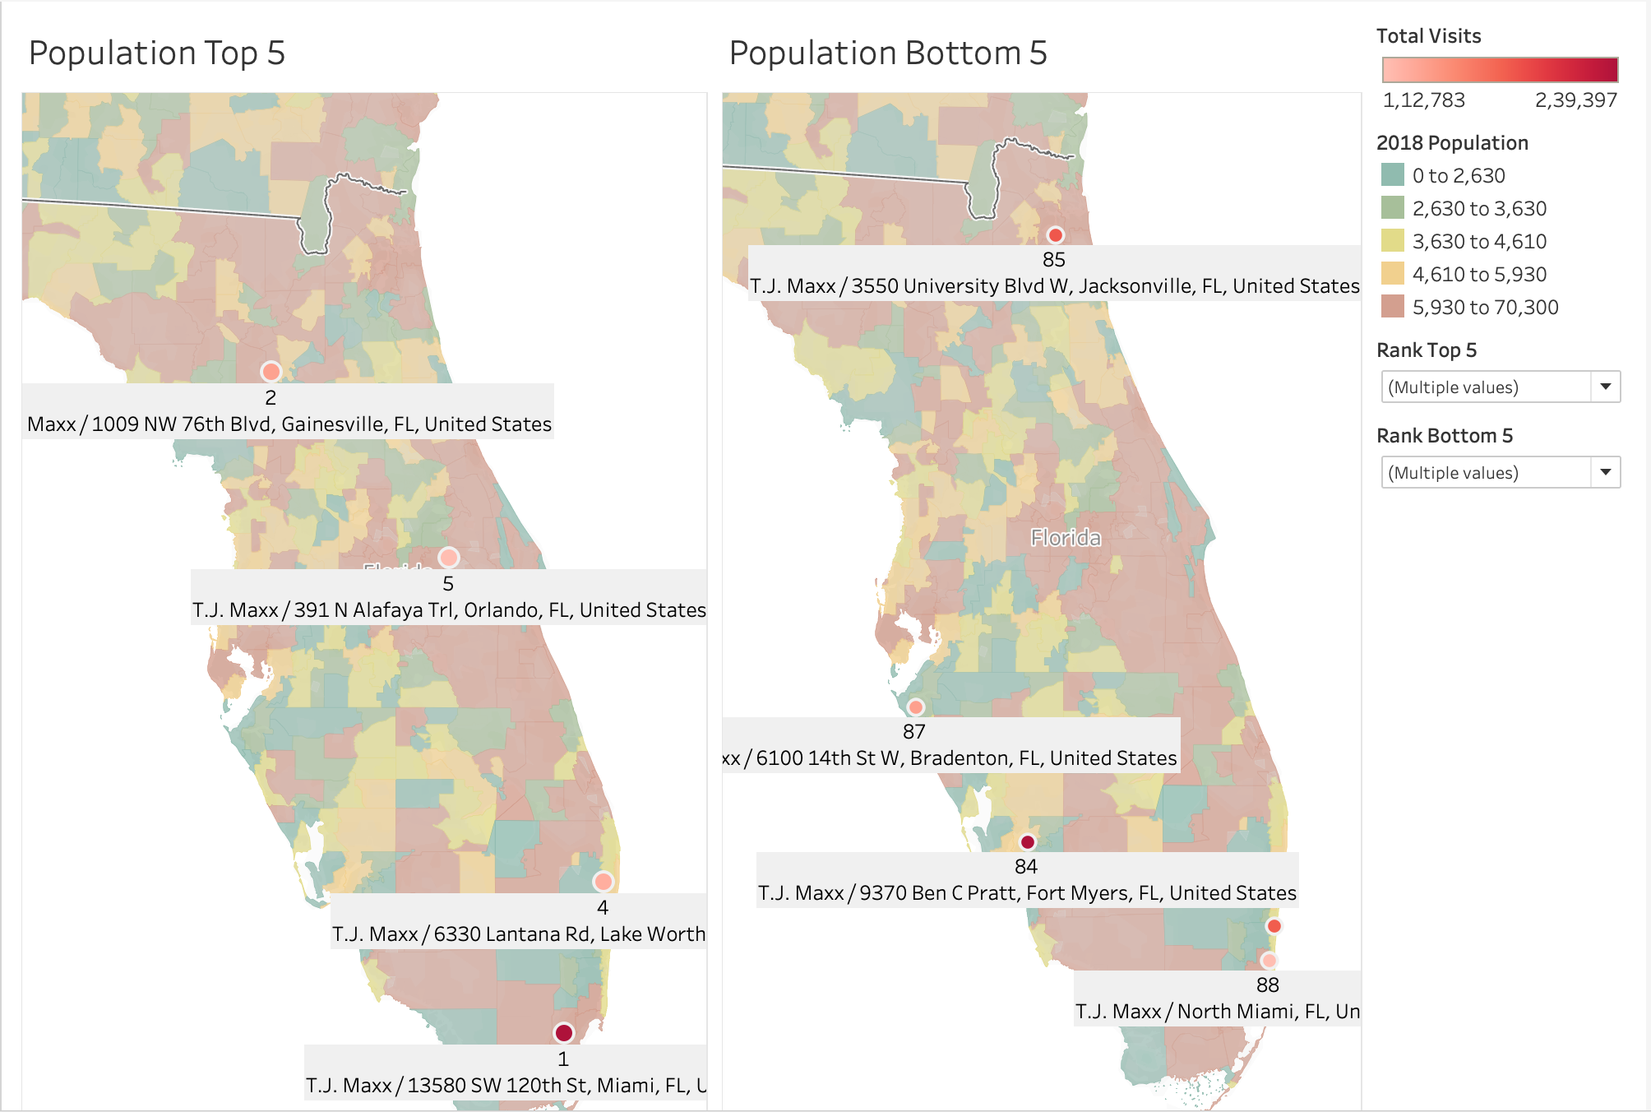
Top 5 stores in neighbourhoods with high population
Bottom 5 stores in neighbourhoods spread across low to high population area

Slide 8
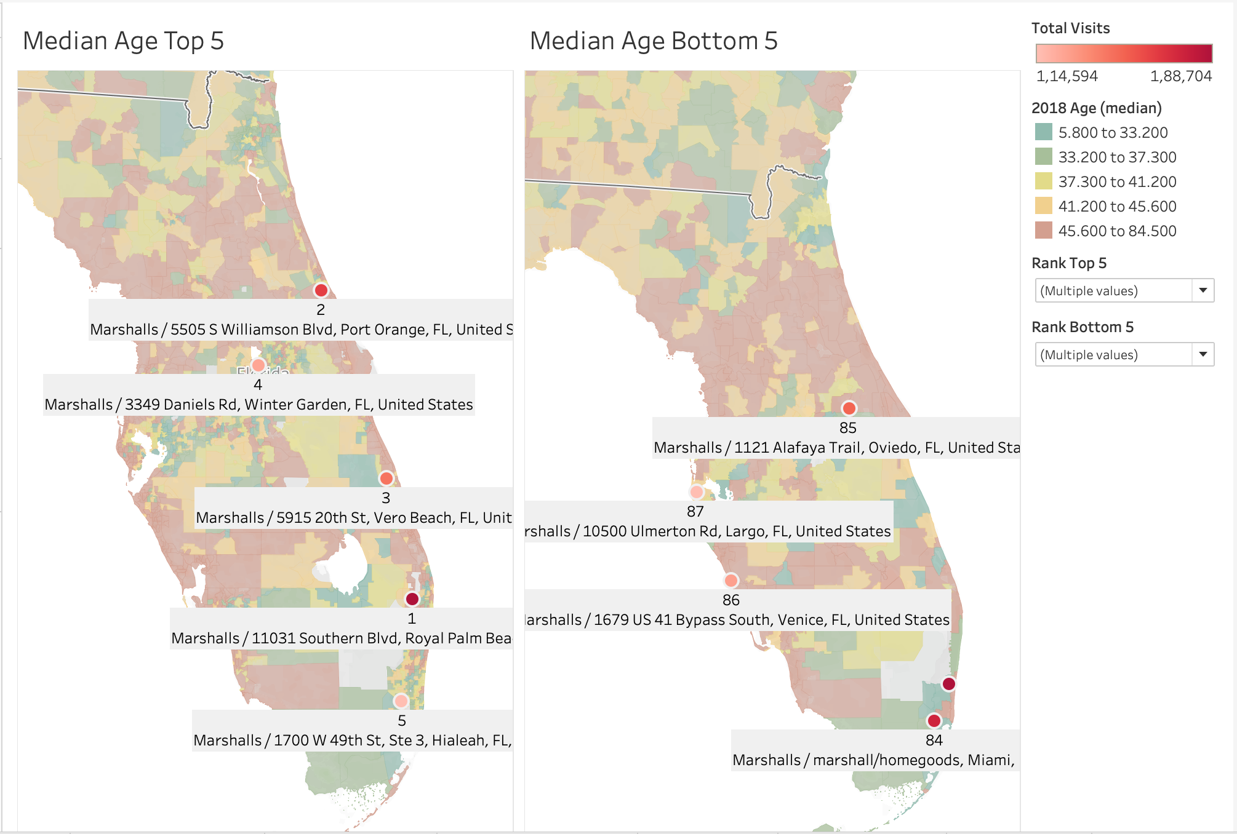
Top 5 stores in neighbourhoods with median age above 45
Bottom 5 stores in neighbourhoods with median age upto 42

Slide 9
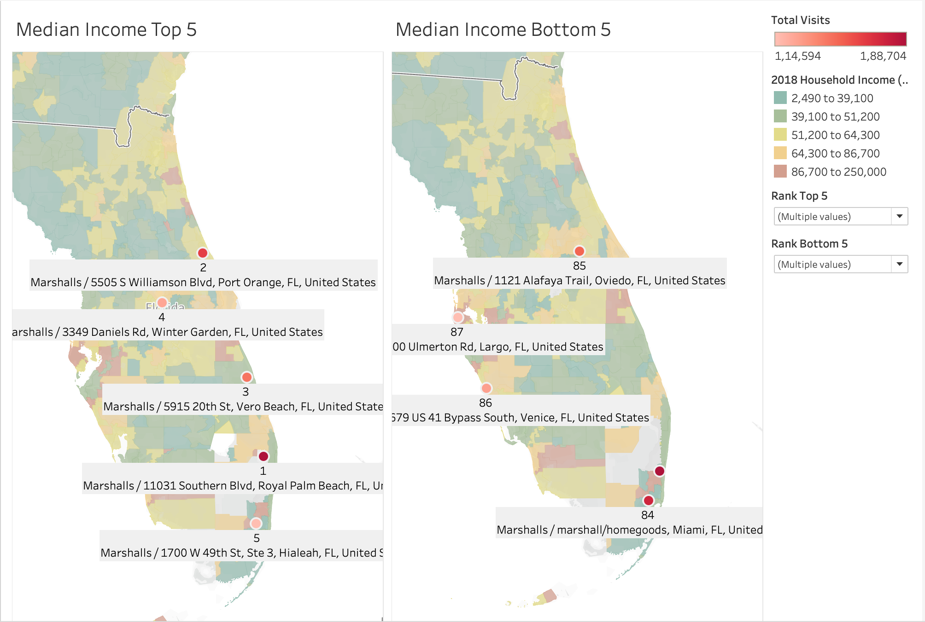
Top 5 stores in neighbourhoods with varied median household income
Bottom 5 stores in neighbourhoods with low median household income

Slide 10
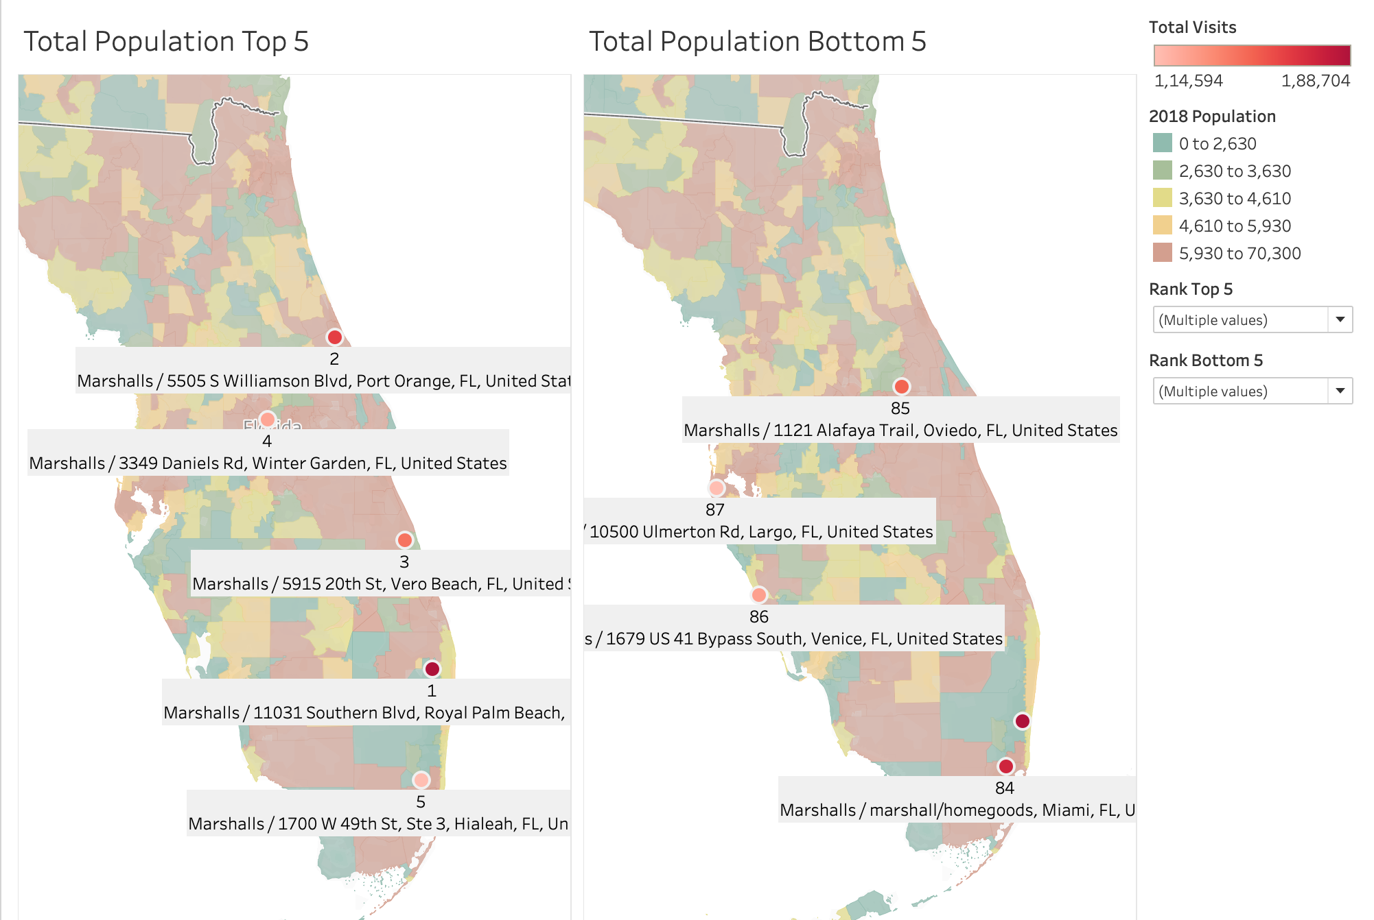
Top 5 stores in neighbourhoods with high population
Bottom 5 stores in neighbourhoods spread across low to high population area

Slide 11
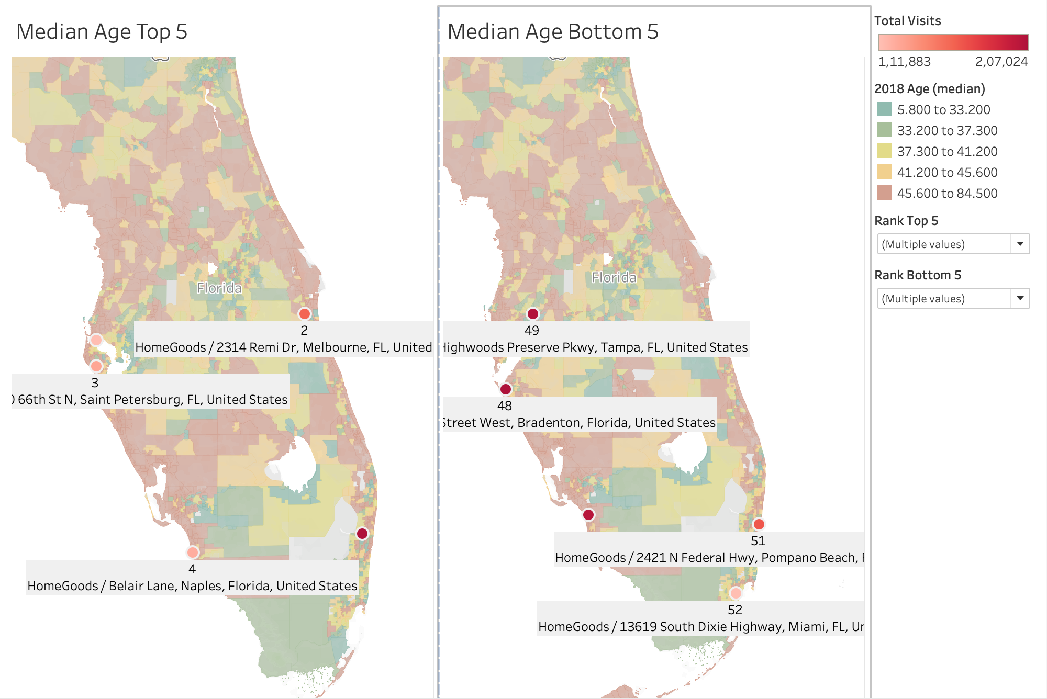
Top 5 stores in neighbourhoods with median age above 45
Bottom 5 stores are in neighborhood with varied median household income

Slide 12
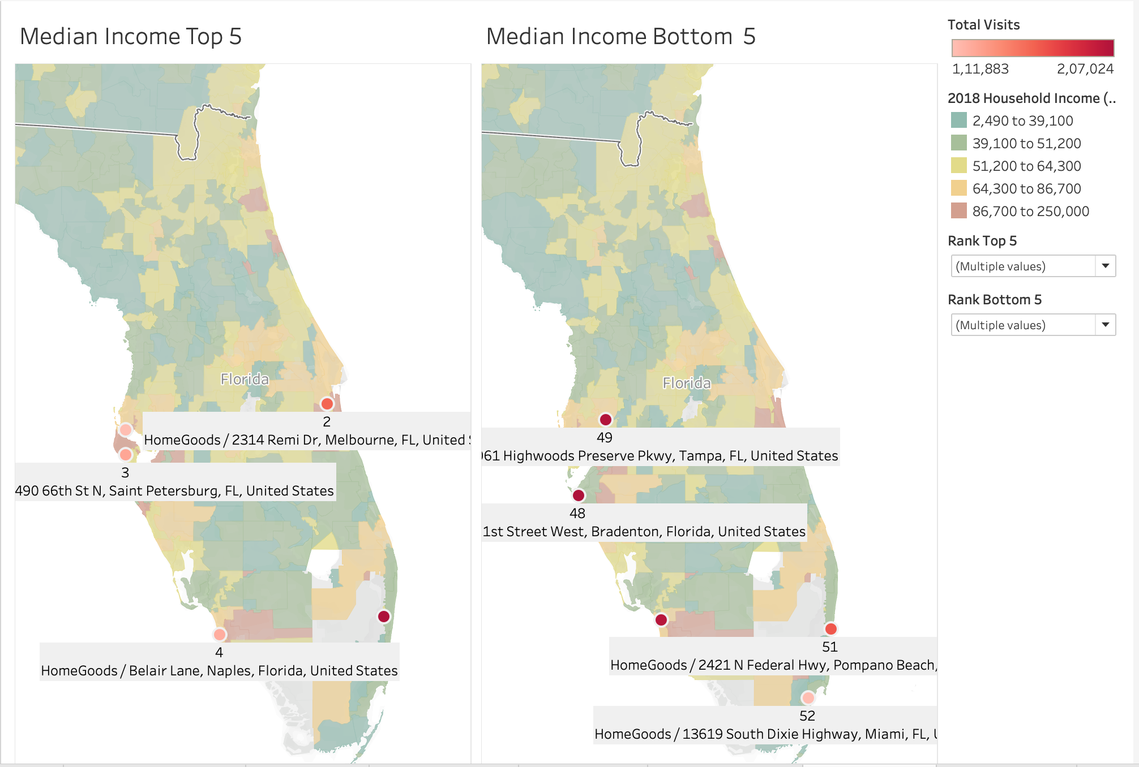
Top 5 stores in neighbourhoods with medium to high median income areas
Bottom 5 stores in neighbourhoods with high median income areas

Slide 13
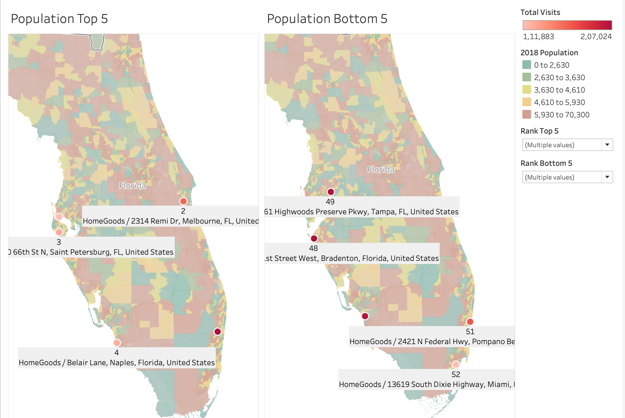
Top 5 stores in neighbourhoods with medium to high population
Bottom 5 stores in neighbourhoods with medium population

Slide 14
Summary
Store | Median Age | Median Household Income | Population
TJ Maxx | Top 5 - upto 37 Bottom 5 - above 41 | Top 5 - Medium- High Bottom 5 - Low | Top 5 - High Bottom 5 - Spread across low to high
Marshalls | Top 5 - Above 45 Bottom 5 - upto 42 | Top 5 - Varied medium income Bottom 5 - Low | Top 5 - High Bottom 5 - spread across high to Low
HomeGoods | Top 5 - Above 45 Bottom 5 - Varied | Top 5 - Medium- High Bottom 5 - High | Top 5 - Medium- High Bottom 5 - Medium

Slide 15
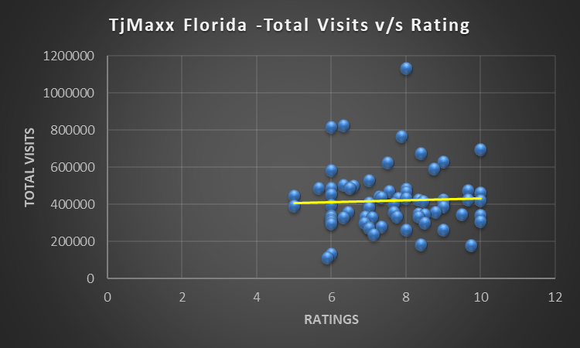
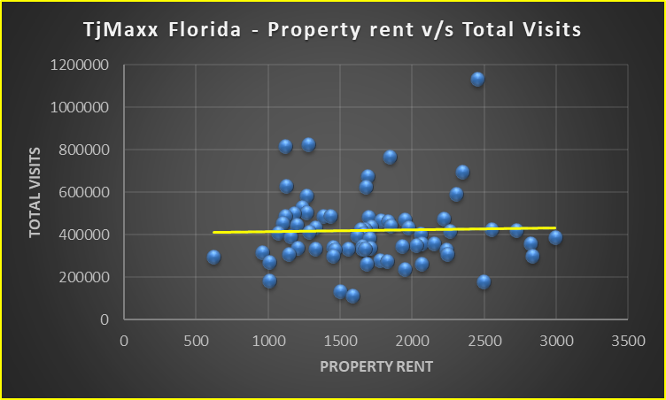
For TJ Maxx in Florida the visits seem to be clustered around the apartments with average ratings between 6-10 that are relatively higher ratings. While we see for lower rated properties there are no visits at all
For TJ Maxx Florida we can focus on areas with higher rated properties
For TJ Maxx in Florida the visits seem to be clustered around the apartments with property rents in the middle range

Slide 16
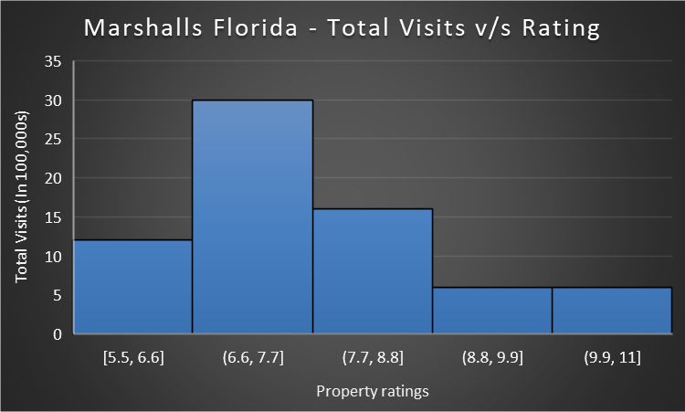
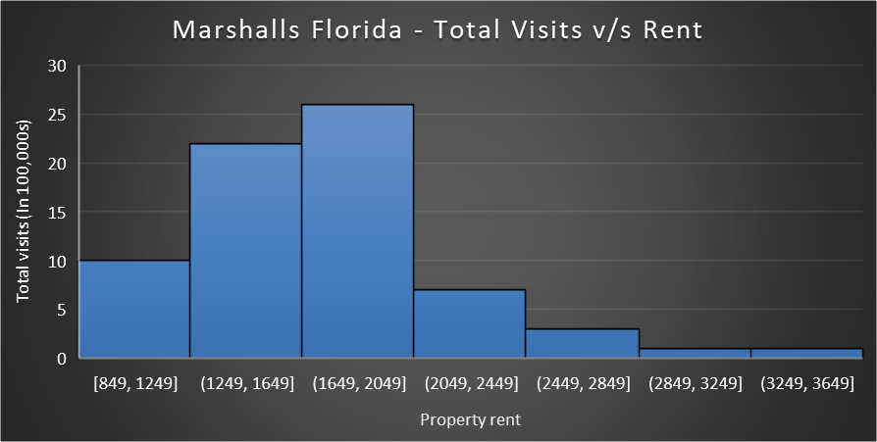
For Marshalls in Florida, we see that the higher visits are centered around properties rated on an average of 6.6 - 7.7 and around the higher ratings the visits decrease.
For Marshall Florida we can focus on the mid-level properties rated 6-8
For Marshalls in Florida, we see that the higher visits are centered around properties with average rent of $1250 - $2050 and around the higher rents the visits decrease
For Marshall Florida we can focus on the mid-level properties rent $1250 - $2050

Slide 17
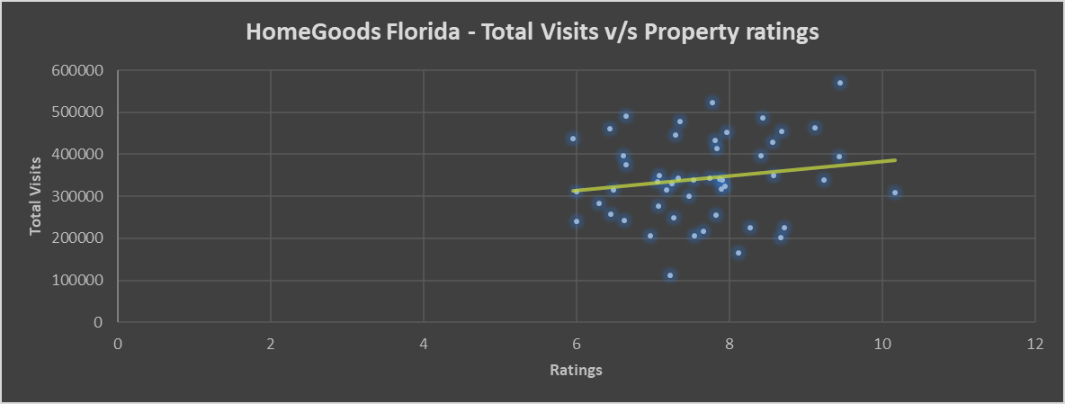
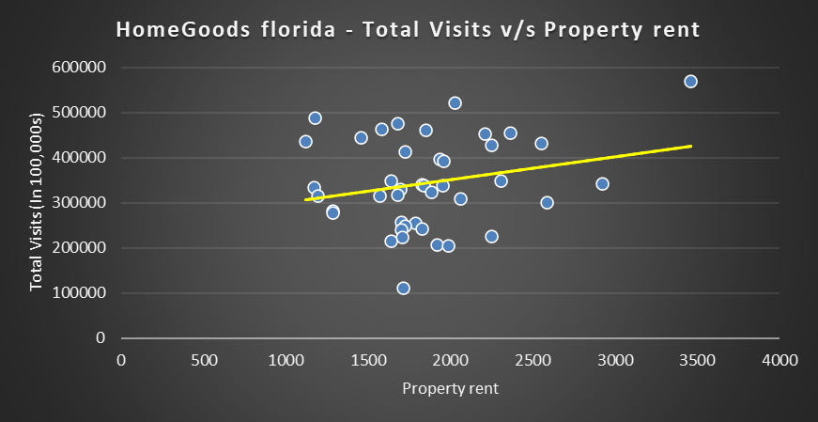
The graph depicts a positive trend between property ratings and a total visits. We see that the higher visits are clustered around properties rated on an average of 7 – 9.
The graph to the right depicts a positive trend between property rent and total number of visits. We see that the higher visits are clustered around properties with average rent of $1500 - $2200.

Slide 18
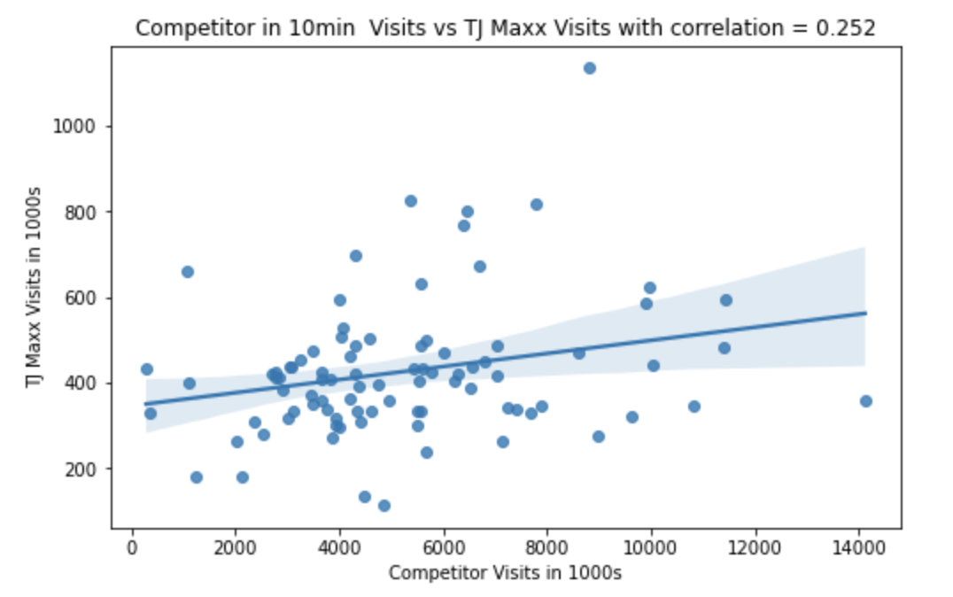
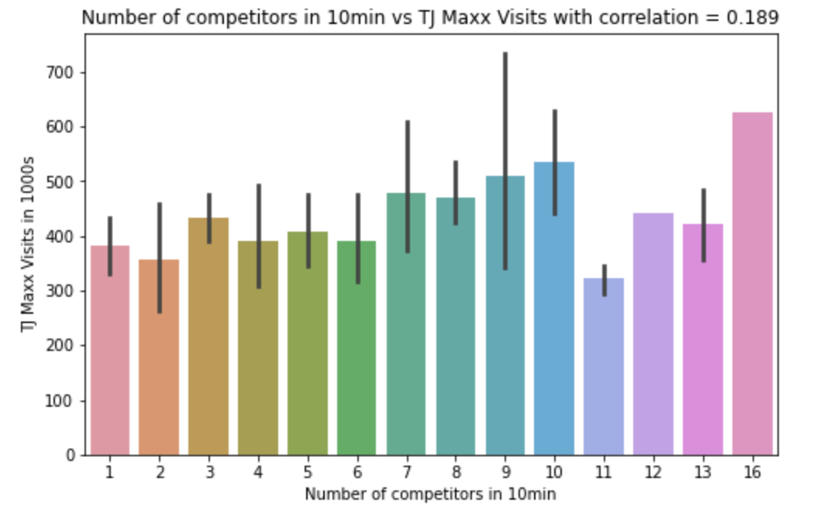

Slide 19
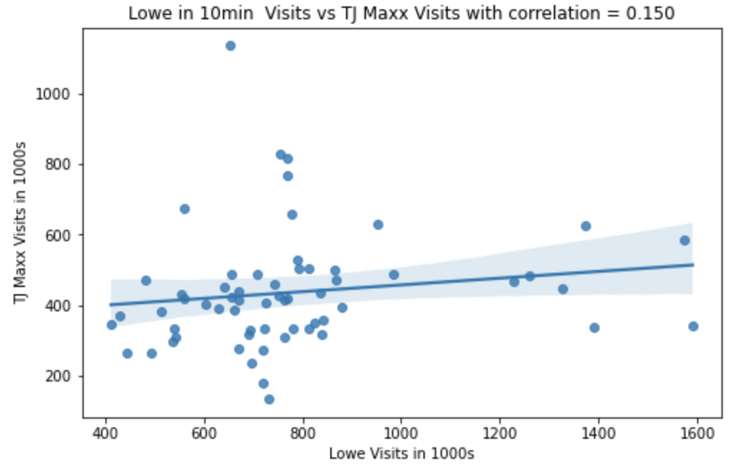
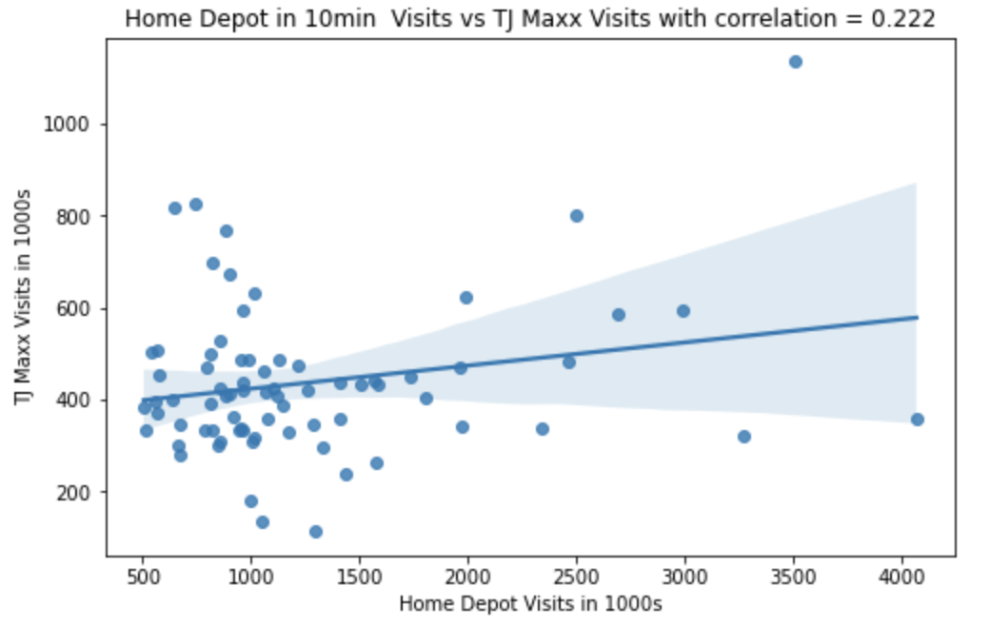
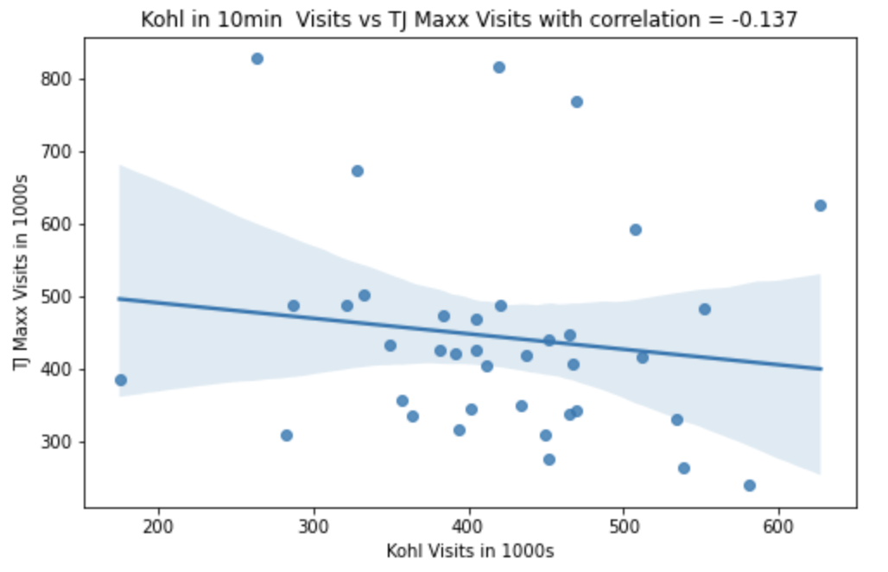
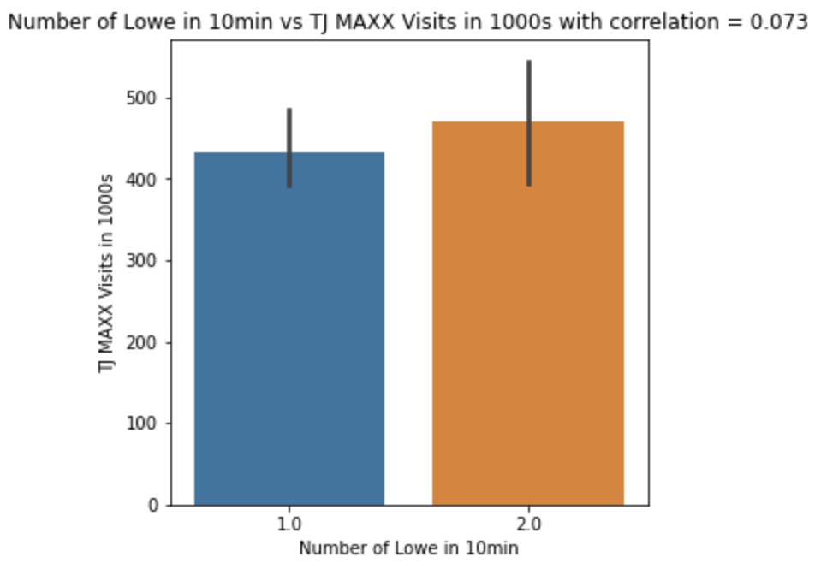
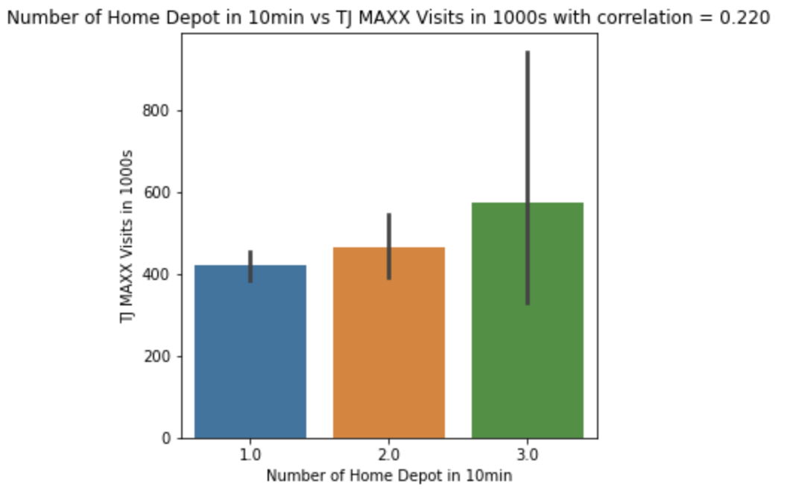
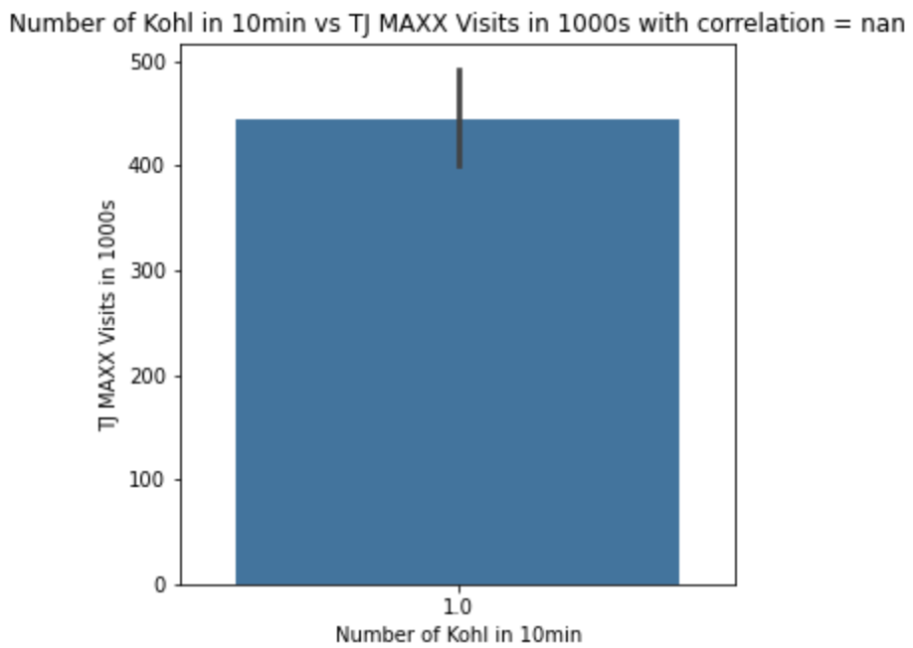

Slide 20
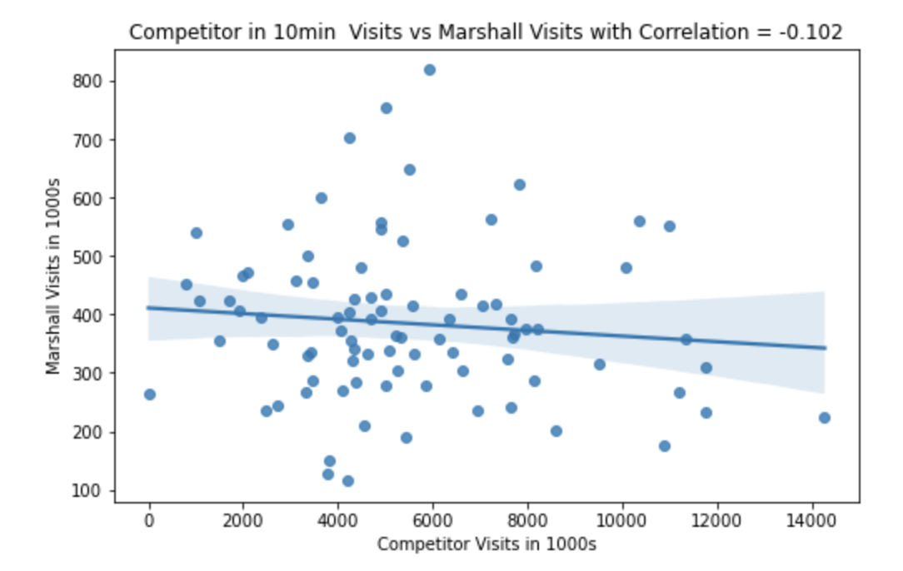
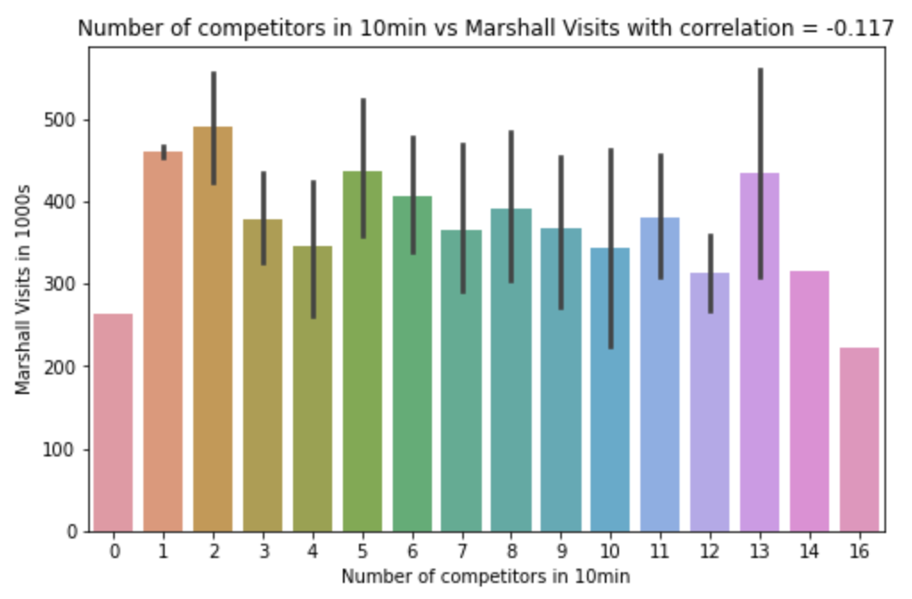

Slide 21
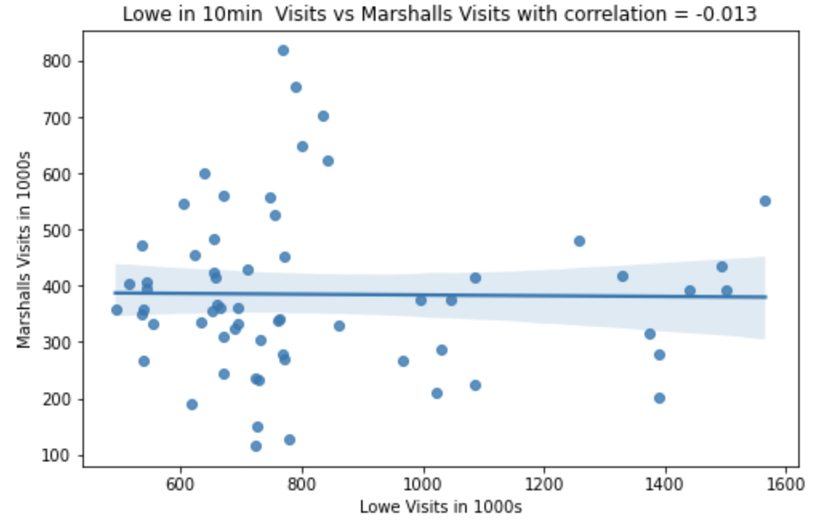
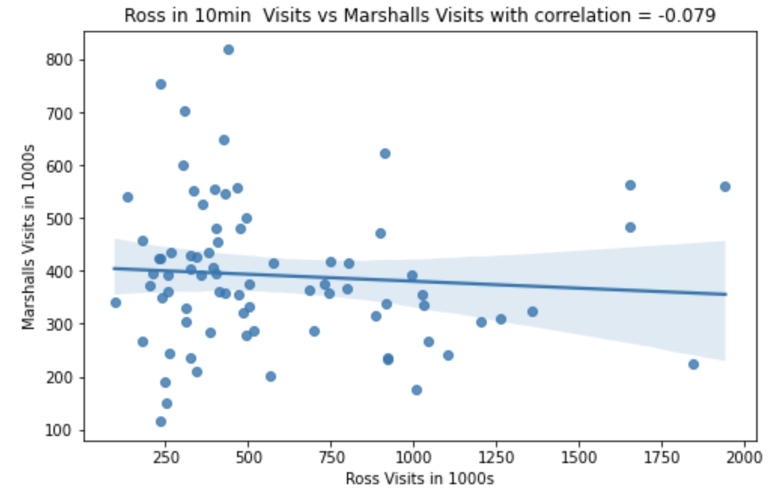
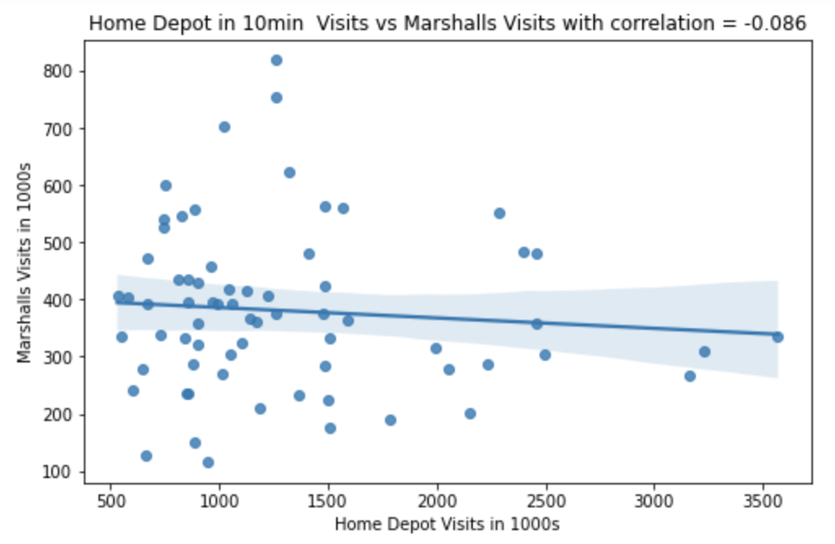
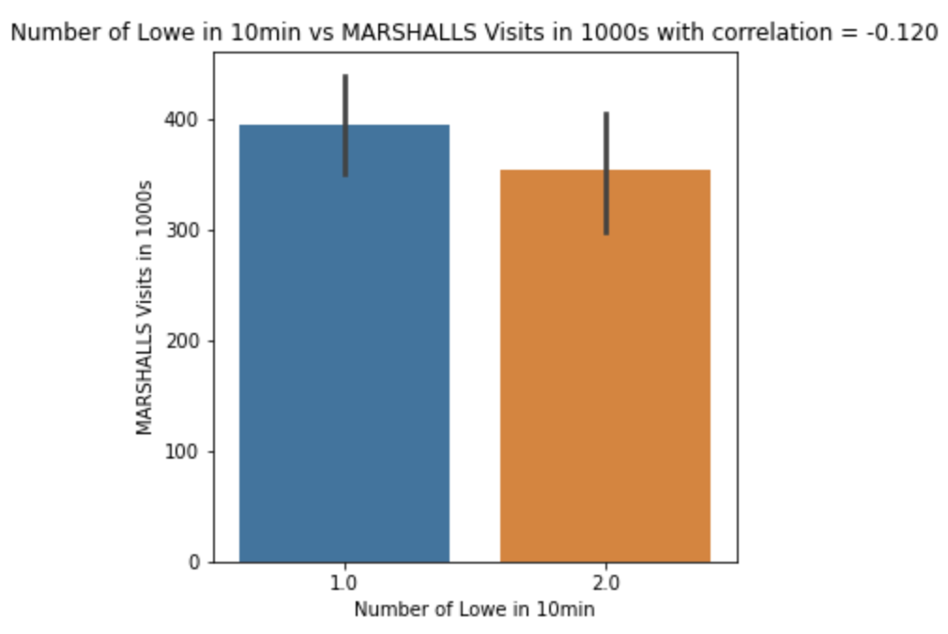
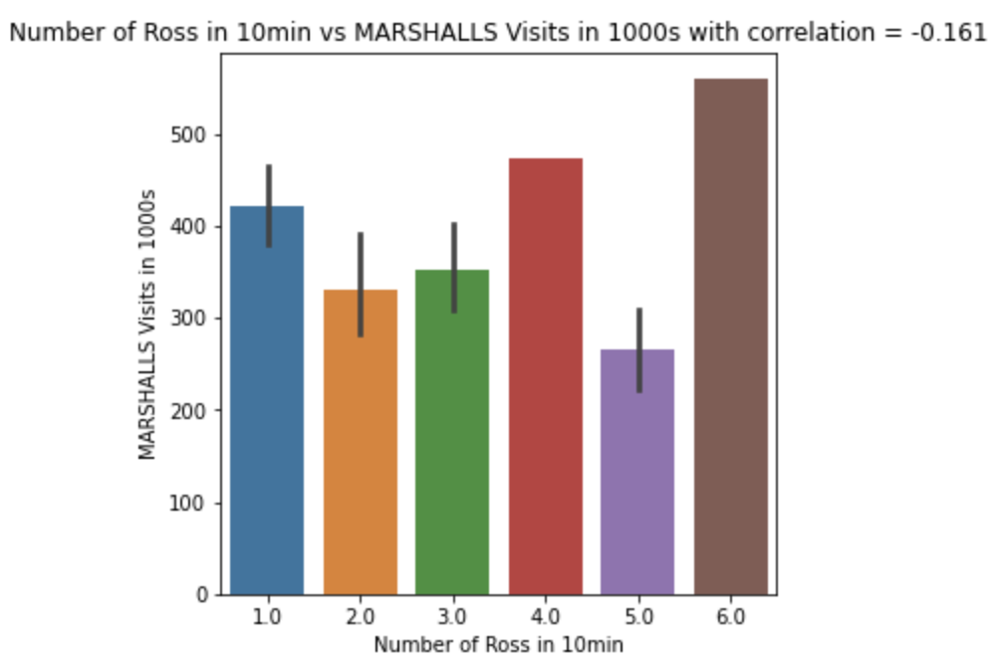
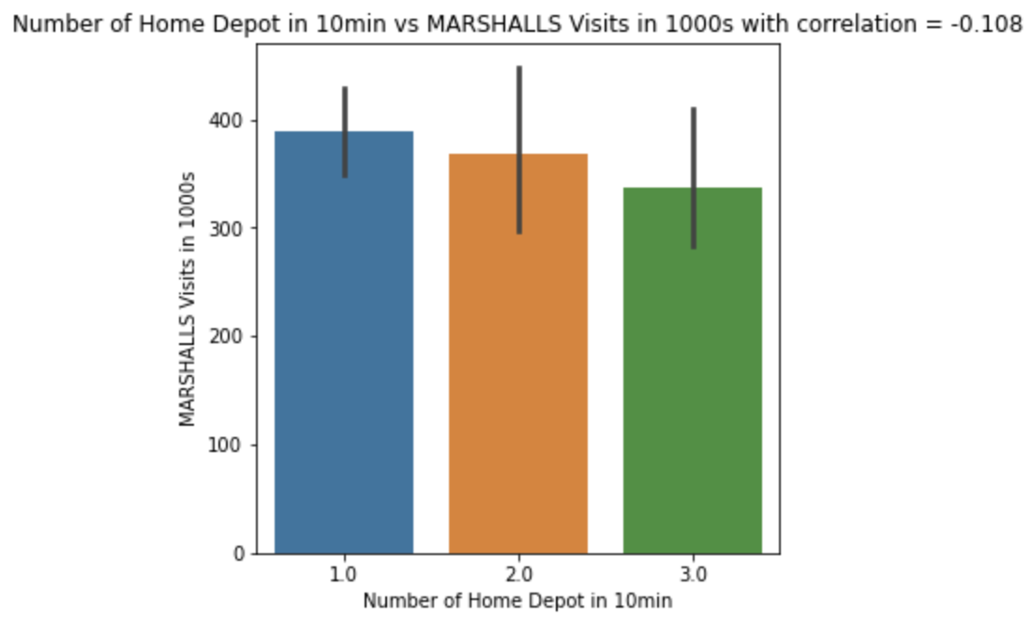

Slide 22
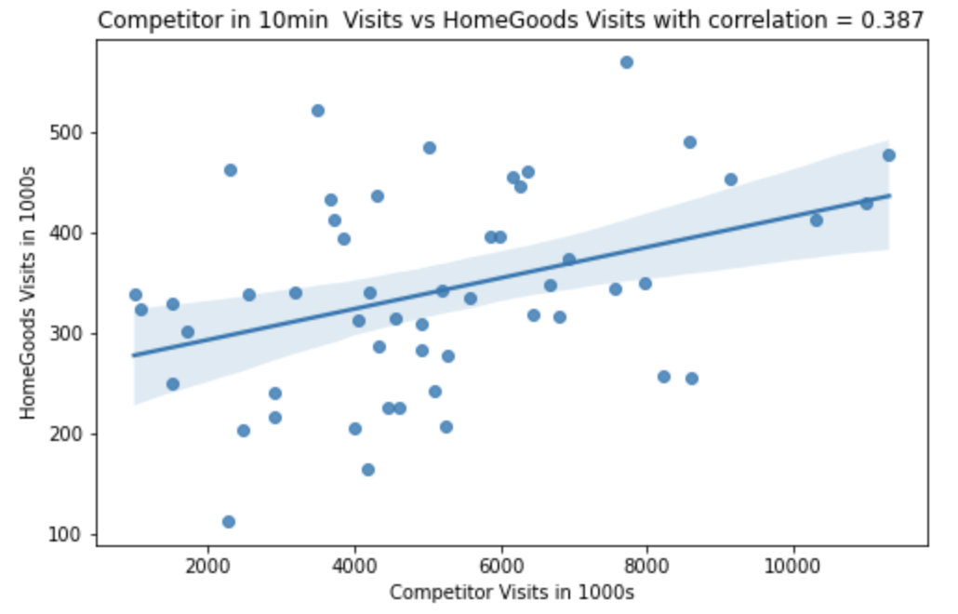
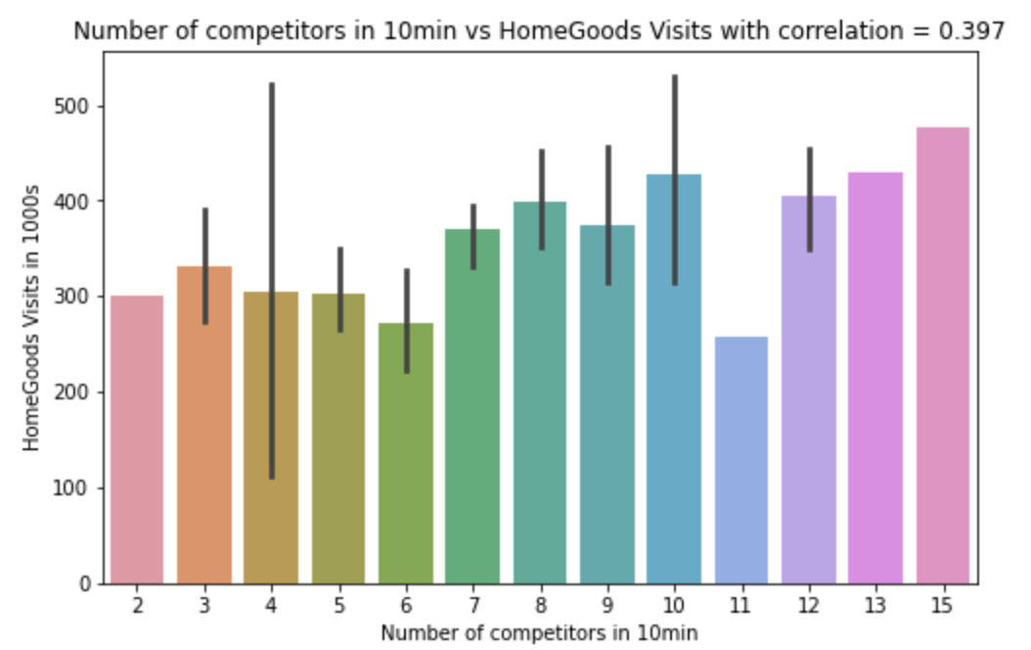

Slide 23
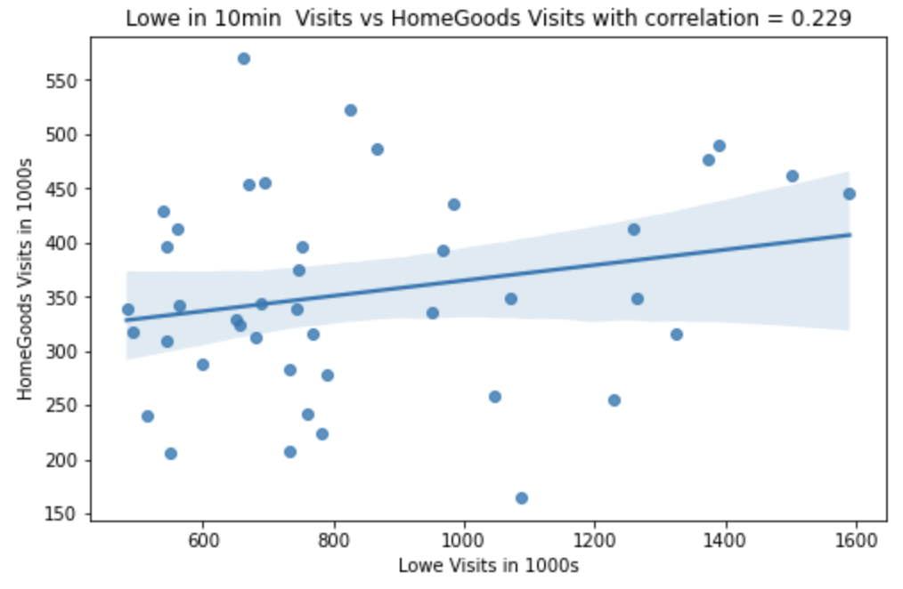
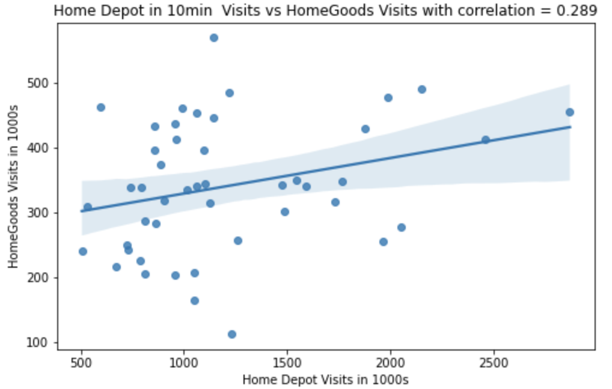
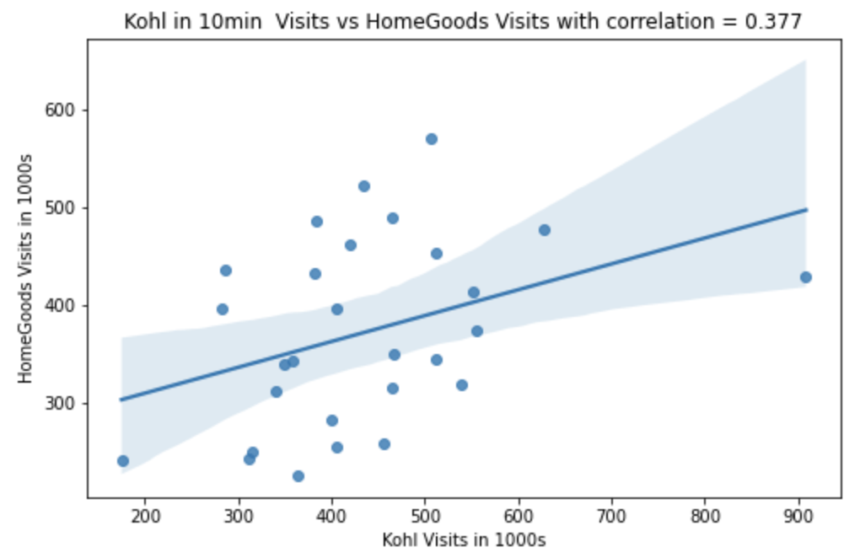
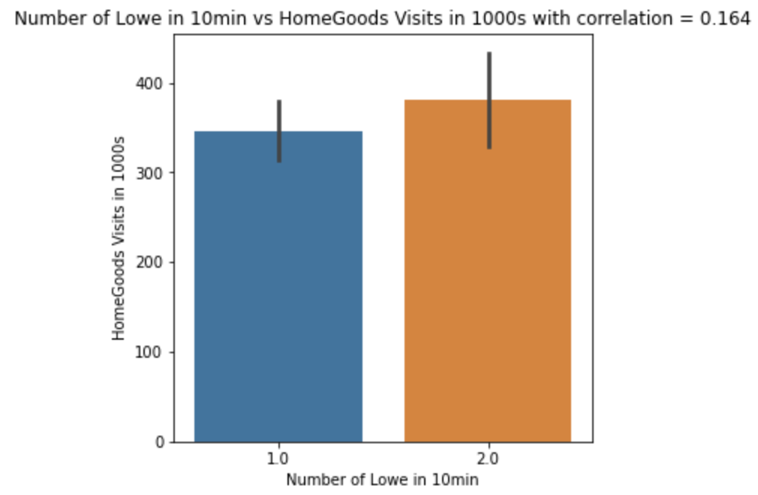
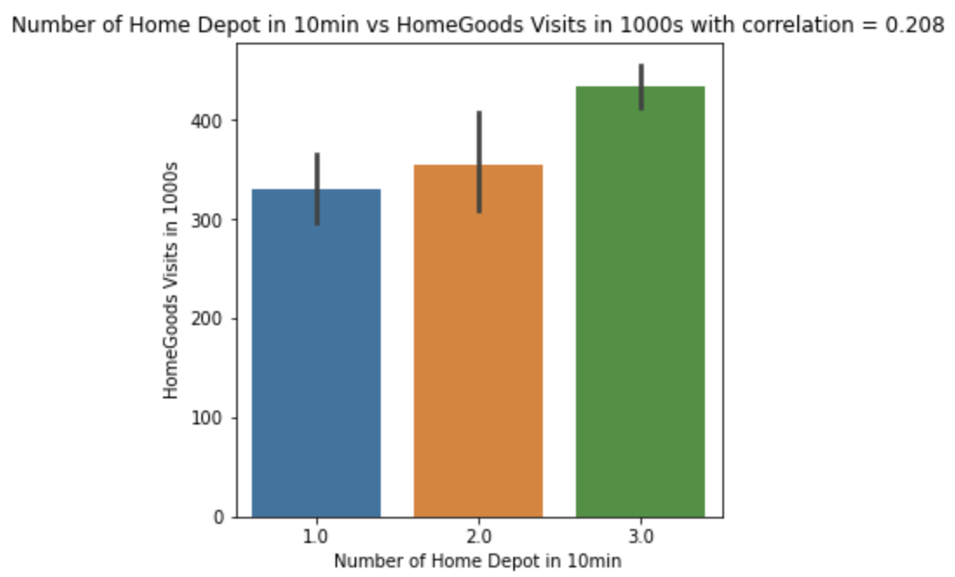
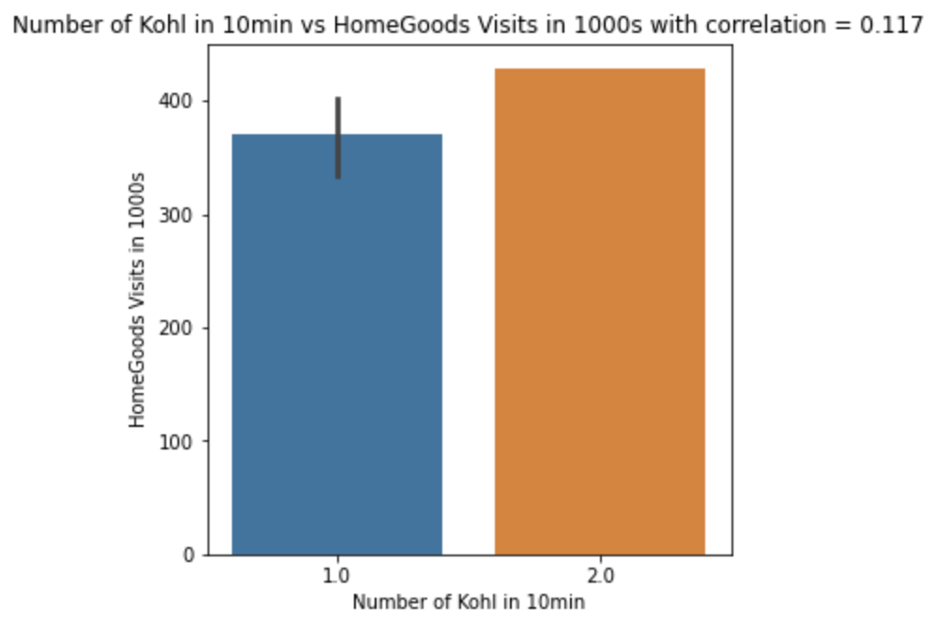

Slide 24
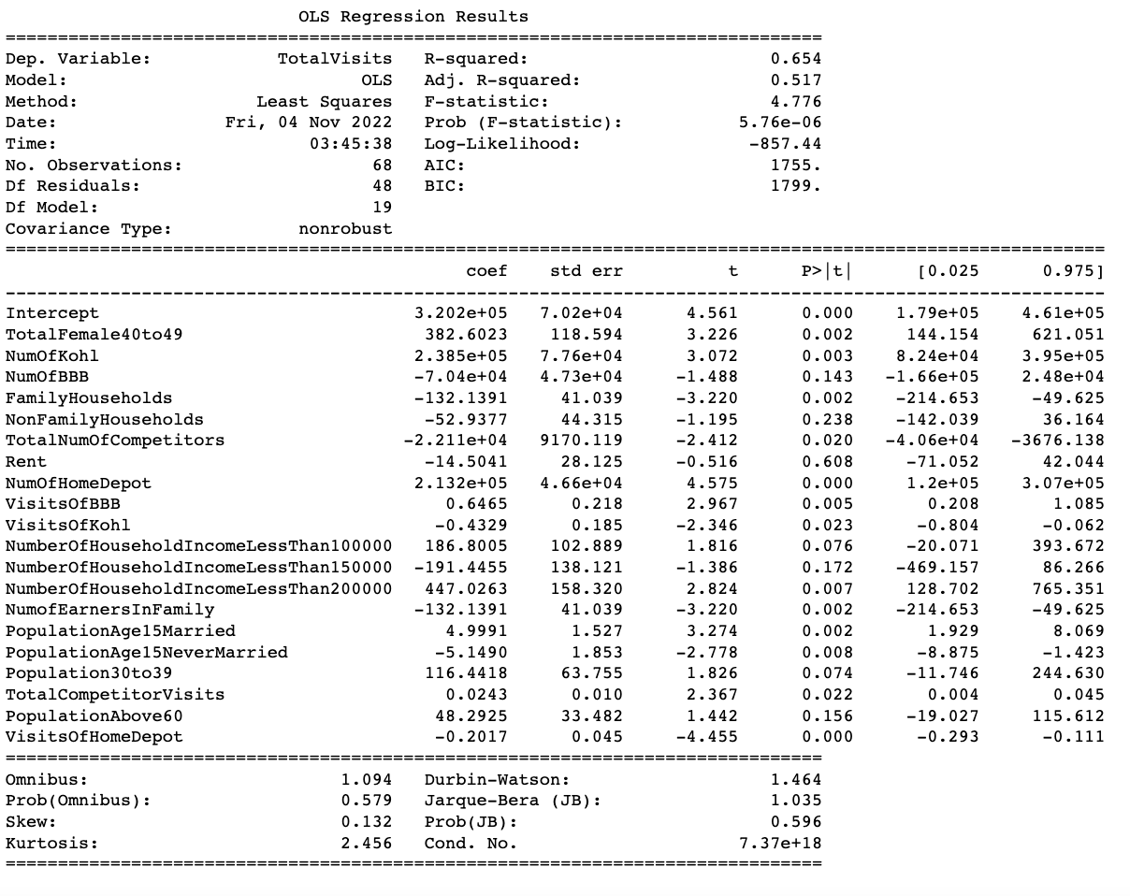
Regression Analysis - T.J. Maxx
R-squared: 0.654
For increase in every 100 visits at Lowe, it increases 28 visits for T.J.Maxx.
For increment by 100 visits at Kohl, it decreases 43 visits at T.J.Maxx
Notes:
We find a few significant features at an alpha value of 0.05 like Visits of Lowe, Visits of HomeDepot, Number of Home Depot Stores

Slide 25
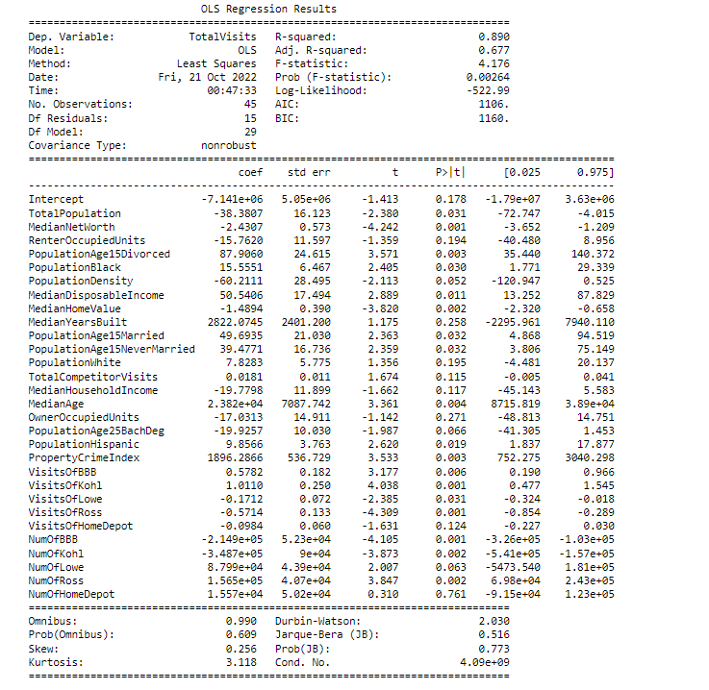
Regression Analysis - HomeGoods
R-squared: 0.890
For every unit increase in Median Disposable Income,it increases 50 visits for HomeGoods, so HomeGoods is likely to do better at higher income areas
For every 100 visits at Kohl, it increases 101 visits at HomeGoods

Slide 26
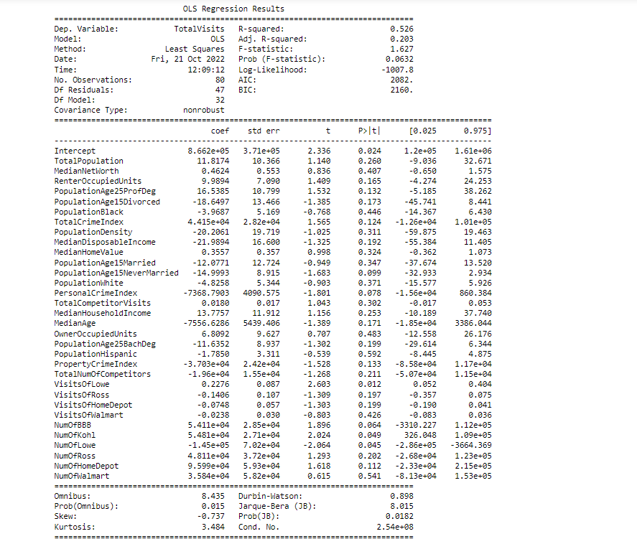
Regression Analysis - Marshalls
R-squared: 0.526
For every 100 visits at Lowe, it increases 23 visits for Marshalls
However, number of Lowe stores has negative relationship with visits at Marshalls.
For every increase in Kohl store, we find increase in visits at Marshalls by ~5000

Slide 27
Regression Predictive Modeling
Algorithm and model : XGBoost which is an implementation of the gradient boosted trees algorithm.
Model Train/Test Data : The existing stores data along with property data from Yardi, competitor stores data and demographics data from the government Census API are aggregated at a Census Tract level to train and test our model based on our previously selected variables.
Prediction : The property data from Yardi and competitor stores data has been aggregated to the Census Tract level along with demographics data from the government Census API to create our previously selected variable for all the tracts in the particular state. The data is used that to predict the number of visits for all those tracts. Further, a qualitative analysis of the predicted tracts is performed to further confirm the model prediction results.

Slide 28
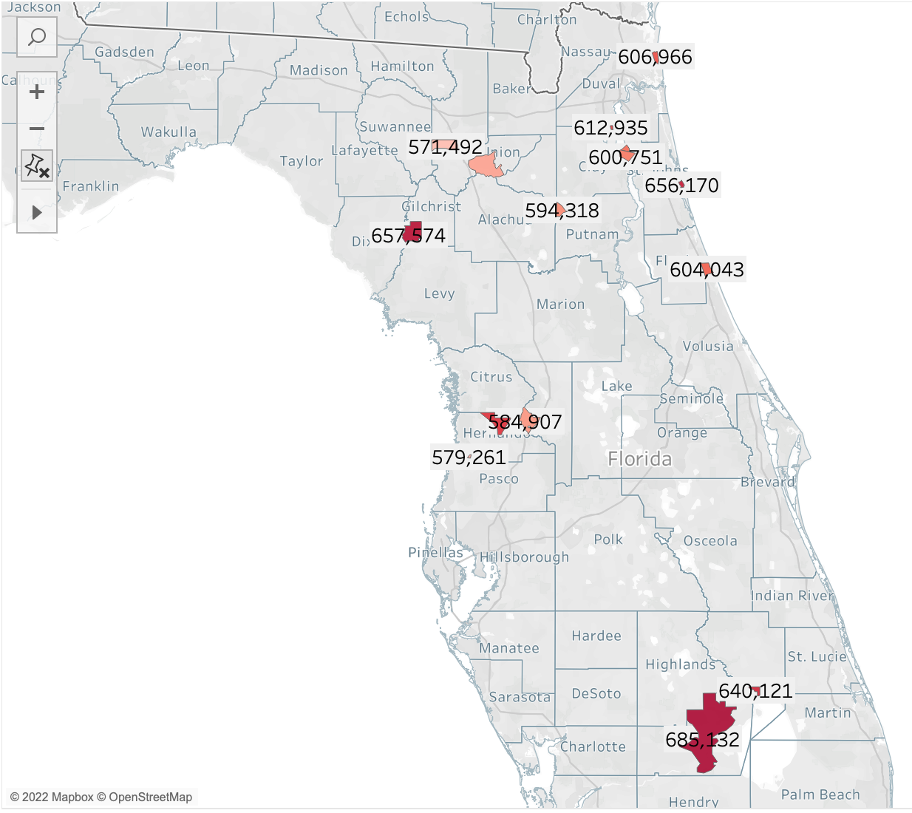
Predicted Locations - T.J. Maxx
Florida
Median household income between 60k to 90k. Population of women is higher
Most tracts have median age between 40 to 55, so decent buying power
Couple of counties have Publix stores nearby, whose presence has shown a positive boost for sales
Education higher in these counties. In these counties have about 15% higher rates of education as compared to other areas in that county with bachelors and masters

Slide 29
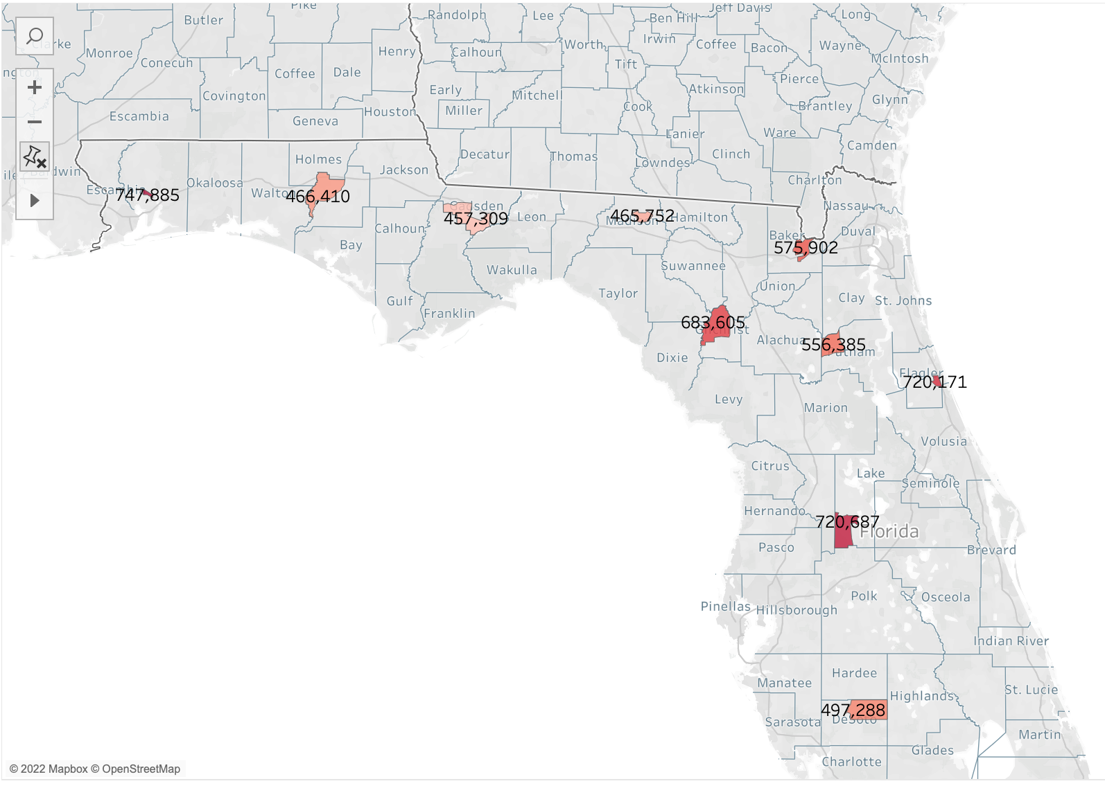
Predicted Locations - Marshalls
Florida
Median household income between 50k- 200k. Poverty rate is steadily declining, in near future willingness to spend will increase
Maximum people here do not have any major health issues, so the expenditure associated with healthcare is relatively lower as compared to other areas of that county
Higher number of families, about 25% population is in age group 5-17 years Marshalls has variety for kids toys, stationery, clothes

Slide 30
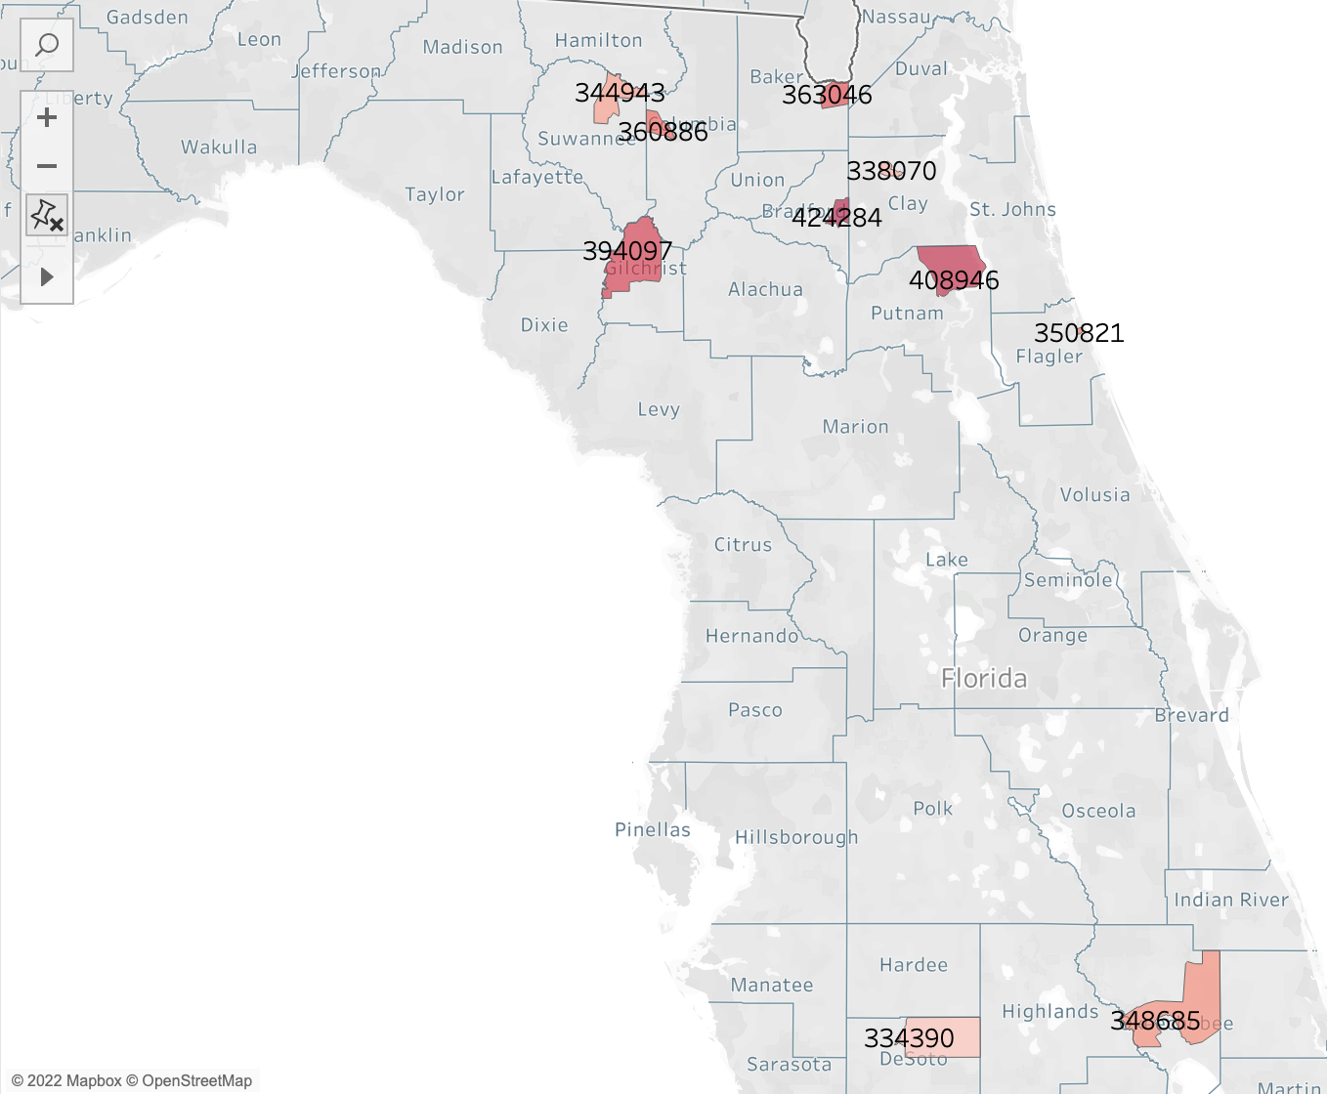
Predicted Locations - HomeGoods
Florida
Median household income – 55k to 95k
Of the occupied units, nearly 70% are priced >100k. About 80% live on ownership here, rather than rent suggesting more families or ancestral pass down of houses. Home décor items will be consumed more in these places
Median age 48-55 years, decent buying power.

Slide 31
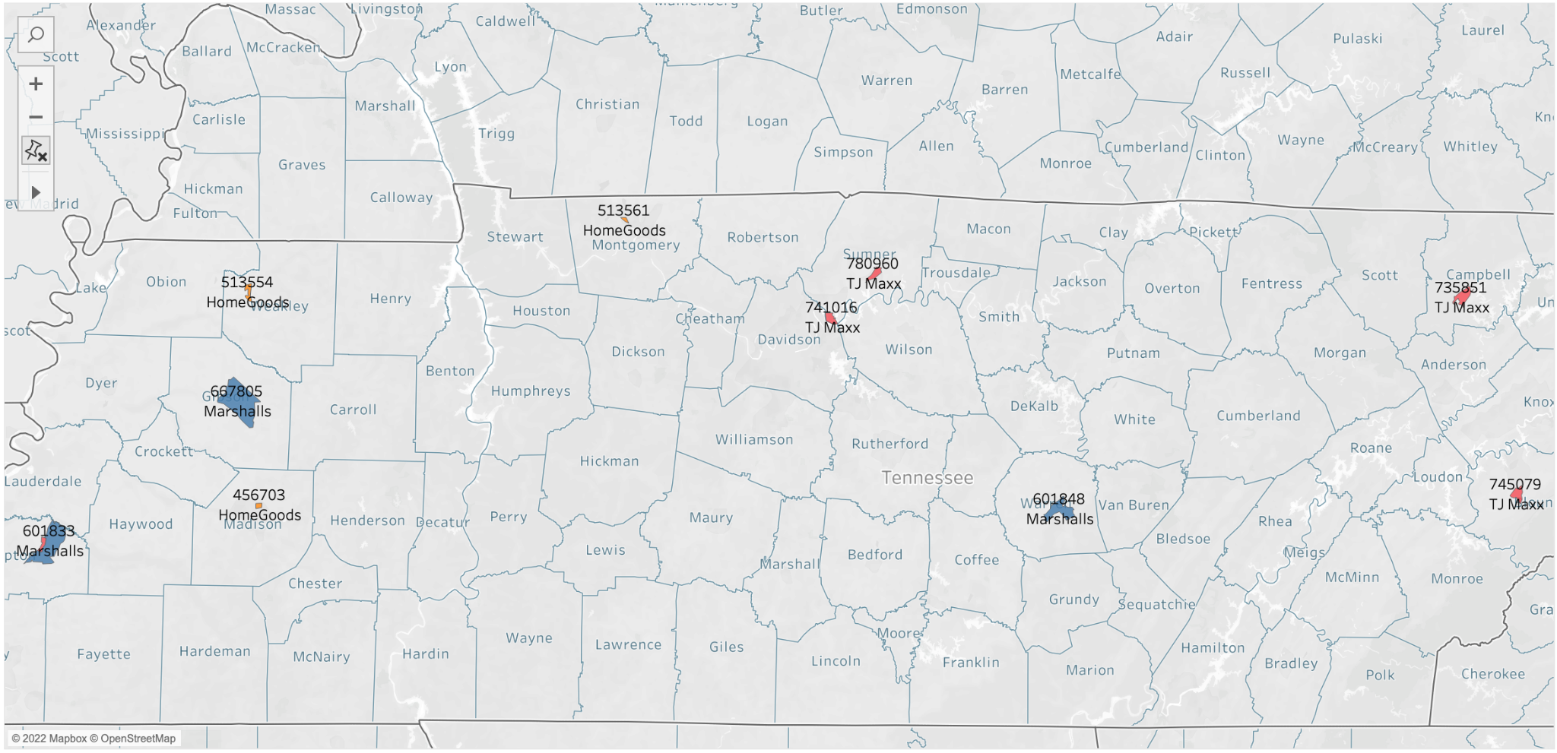
Predicted Locations - Tennessee
 | T.J. Maxx
 | Marshall | HomeGoods
Tennessee | Median Age: ~43 High Married Population ~50% Median Income: 65k | Median Age: ~41 High Married population: 50% High female population: 55% | Median Income: 40k Higher male population

Slide 32
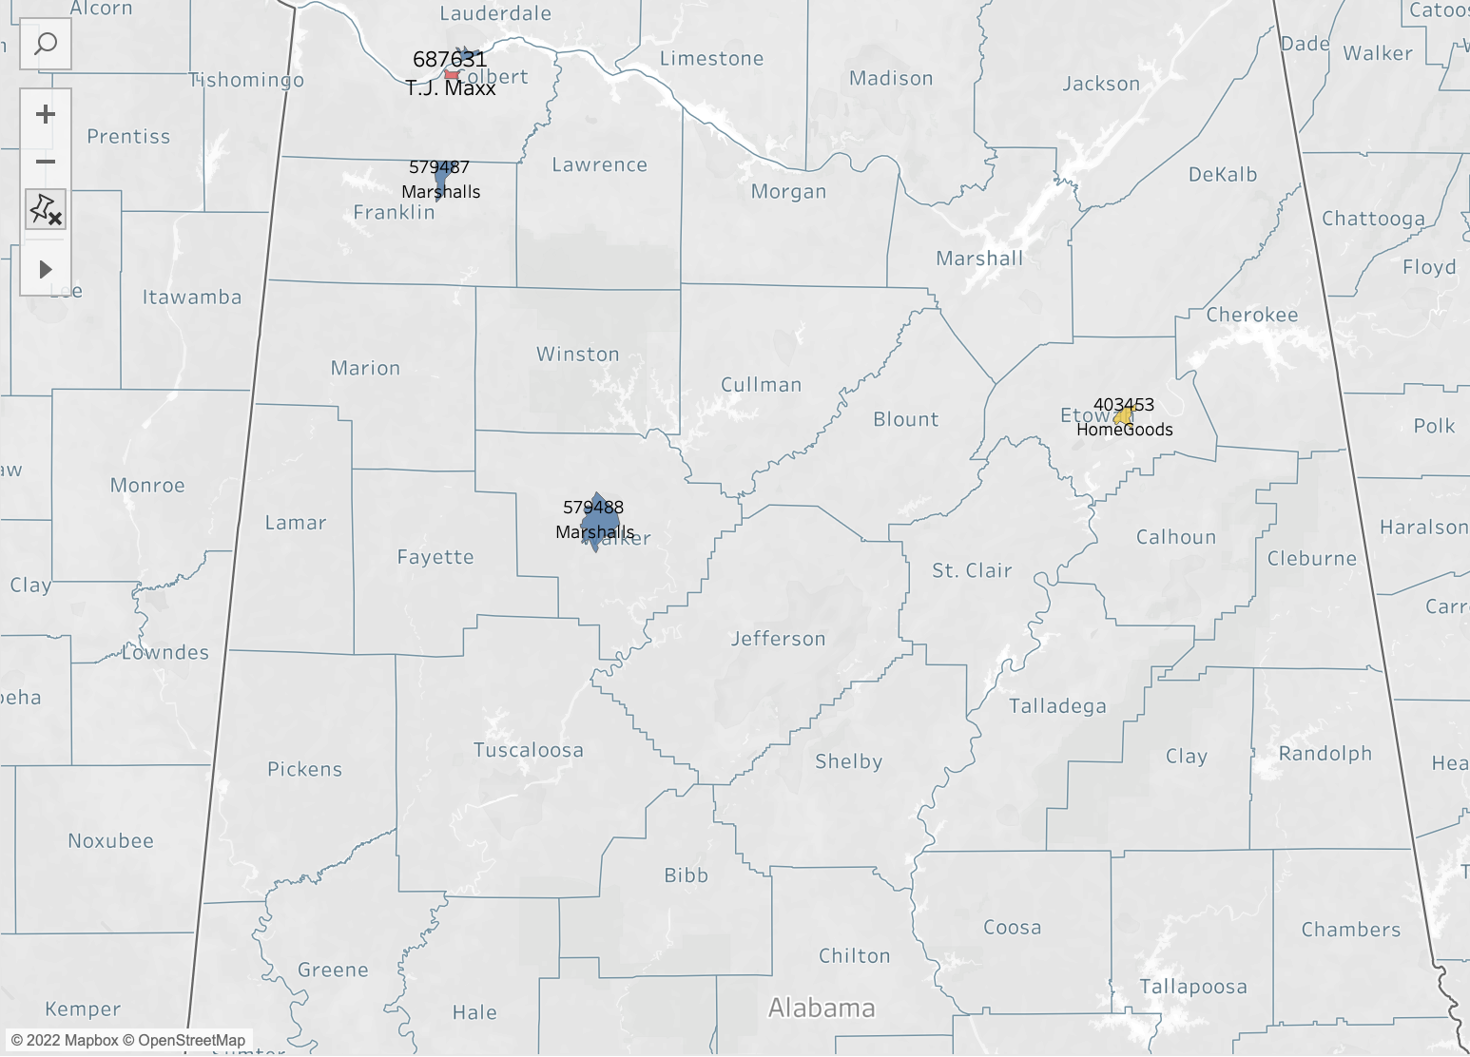

Predicted Locations - Alabama
 | Alabama
T.J. Maxx | Median Age: ~47 High Female Population Higher married population: 45-50%
Marshall | Median age: ~40 Median Income: 50k Poverty Rate: ~15% Higher married population: ~45-50%
HomeGoods | Median Age: ~40 Median Income: 45k Higher male population: ~55% Fastest growing tracts

Slide 33
Thank you!

Slide 34
Appendix A : T.J. Maxx (FLorida)
GEO ID | County | Tract Number | Predicted Visits
12043000300 | Glades County | Tract 3 | 685132
12093910601 | Okeechobee County | Tract 9106.01 | 640121
12053040601 | Hernando County | Tract 406.01 | 616691
12041950202 | Gilchrist County | Tract 9502.02 | 657574
12035060304 | Flagler County | Tract 603.04 | 604043
12109020500 | St. Johns County | Tract 205 | 656170
12109020807 | St. Johns County | Tract 208.07 | 600751
12019030303 | Clay County | Tract 303.03 | 612935
12089050201 | Nassau County | Tract 502.01 | 606966
12109020804 | St. Johns County | Tract 208.04, | 603185

Slide 35
Appendix B : Homegoods (FLorida)
GEO ID | County | Tract Number | Predicted Visits
12027010101 | DeSoto County | Tract 101.01 | 334390
12093910101 | Okeechobee County | Tract 9101.01 | 348685
12035060103 | Flagler County | Tract 601.03 | 350821
12107950100 | Putnam County | Tract 9501 | 408946
12007000100 | Bradford County | Tract 1 | 424284
12019030103 | Clay County | Tract 301.03 | 338070
12003040101 | Baker County | Tract 401.01 | 363046
12041950100 | Gilchrist County | Tract 9501 | 394097
12023110201 | Columbia County | Tract 1102.01 | 360886
12121970100 | Suwannee County | Tract 9701 | 344943

Slide 36
Appendix C : Marshall (FLorida)
GEO ID | County | Tract Number | Predicted Visits
12113010504 | Santa Rosa County | Tract 105.04 | 747885
12069031202 | Lake County | Tract 312.02 | 720687
12035060208 | Flagler County | Tract 602.08 | 720171
12041950100 | Gilchrist County | Tract 9501 | 683605
12003040202 | Baker County | Tract 402.02 | 575902
12107950300 | Putnam County | Tract 9503 | 556385
12027010101 | DeSoto County | Tract 101.01 | 497288
12133970200 | Washington County | Tract 9702 | 466410
12079110301 | Madison County | Tract 1103.01 | 465752
12039020800 | Gadsden County | Tract 208 | 457309

Slide 37
Appendix D : T.J. Maxx (Tennessee)
GEO ID | County | Tract Number | Predicted Visits
47165020800 | Sumner County | Tract 208 | 780960
47167040700 | Tipton County | Tract 407 | 778212
47009011102 | Blount County | Tract 111.02 | 745079
47165021103 | Sumner County | Tract 211.03 | 741015
47013950500 | Campbell County | Tract 9505 | 735850

Slide 38
Appendix E: Homegoods (Tennessee)
GEO ID | County | Tract Number | Predicted Visits
47125101101 | Montgomery County | Tract 1011.01 | 513560
47183968203 | Weakly County | Tract 9682.03 | 511354
47113001603 | Madison County | Tract 16.03 | 456703
Marshalls (Tennessee)
GEO ID | County | Tract Number | Predicted Visits
47053966300 | Gibson County | Tract 9663 | 667805
47167040602 | Tipton County | Tract 406.02 | 601832
47177930600 | Warren County | Tract 9306 | 601848

Slide 39
Appendix F : T.J. Maxx (Alabama)
GEO ID | County | Tract Number | Predicted Visits
01001020801 | Autauga County | Tract 208.01 | 704288
01113030402 | Russell County | Tract 304.02 | 700825
01045020802 | Dale County | Tract 208.02 | 690922
01039961800 | Covington County | Tract 9618 | 701911
01033020300 | Colbert County | Tract 203 | 687631

Slide 40
Appendix G : Homegoods (Alabama)
GEO ID | County | Tract Number | Predicted Visits
47125101101 | Montgomery County | Tract 01 | 403450
01113030200 | Russell County | Tract 302 | 401782
01055000200 | Etowah County | Tract 02 | 400636
Marshalls (Alabama)
GEO ID | County | Tract Number | Predicted Visits
01077010100 | Lauderdale County | Tract 101 | 579489
01059973000 | Franklin County | Tract 9730 | 579023
01127020100 | Walker County | Tract 201 | 578428

Slide 41
 | TJ Maxx | Marshall | Homegoods
Alabama | Median Age: 45-50 High Female Population Low to mid income Higher married population(45-50%) | Median age: 40 Median Income: 50k Poverty Rate: 15% Higher married population(45-50%) | Median Age: 40 Median Income: 45k Higher male population Fastest growing tracts
Tennessee | Median Age: ~43 High Married Population (50%) Median Income: 65k | Median Age: 41 High Married population(~50%) High female population (55%) | Median Age: 35 High Never Married Population: 55% Higher male population

Slide 42

Marshall Tennessee store visits are inversely proportional to the number of medium rated properties ie More medium rated properties around a store corresponds to lower number of visits

Slide 43

Homegoods TN store visits are inversely proportional to the average rent of the properties i.e. higher rent properties tend to result in lower store visits

Slide 44

TJ Maxx Tennessee store visits are directly proportional to the number of high rated properties i.e. more high rated properties around a store corresponds to higher number of visits
Alternatively, more medium rated properties corresponds to comparatively lower number of visits

Slide 45

TJ Maxx Alabama store visits are directly proportional to the number of high rated properties ie More high rated properties around a store corresponds to higher number of visits

Slide 46


The graph on the left represents the total number of visits per store number. From the graph, we see negative correlation: with increase in number of units numbers of visits are decreasing.
The graph on the right shows the total number of visits and the total sqft. There is negative correlation and varied customer preferences across different stores in Alabama

Slide 47



County Comparison Regression Analysis

Slide 48
Inference
• T.J. Maxx : 55+ stores within 1 mile. However, when we see visits within 1 mile, number of visits having 0, 1 , 2 or 3 stores is almost same. However, if we see the total visits within 1.5 miles with 1 publix store within 1.5 mile, then visits were more as compared to 0 Publix stores. So in that case, its helping our visits increase
•Marshalls: 50+ Marshalls stores have 1 Publix store within 1.5 miles. However, we observe that maximum number of visits are observed by those stores which have 3 Publix stores within 1.5 miles
•HomeGoods: About 30 HomeGoods stores have 1 Publix store within 1.5 miles and highest number of visits is also observed in HomeGoods when 1 Publix store is present within 1-2 miles

Slide 49

County Regression Prediction - T.J. Maxx

Slide 50

County Regression Prediction - Marshalls

Slide 51

County Regression Prediction - HomeGoods

Slide 52
Feature Selection for Modelling
We find that T.J. Maxx and HomeGoods do well, when other competitor stores are present and a good amount of footfall occurs for them as well.
Property Crime Index, although unexplainable, is significant for total visits of stores.
Different income households have an impact on the number of stores and total visits for those stores
Higher populated areas have higher total visits, hence impacting significantly
Even though some amount of co-tenancy is required, about over 4 stores on average in an area is causing cannibalization effect
T.J. Maxx | Marshalls | HomeGoods
Number of Home Depot | Visits to stores like Lowe | Visits to stores like Kohl, BBB, Ross and Lowe
Number of Lowe | Number of Kohl stores | Median Home Value
Visits to stores like walmart, Lowe, HomeDepot | Median Income | Median Age
Median Age | Number of Lowe stores (inversely related) | Median Income
Population density | Crime Index | Property Crime Index

Slide 53


Slide 54


